Slide 1
Fact and Fiction in Nutrition and Agriculture
Outline
The science of nutrition
Organic and conventional produce*
High fructose corn syrup
Gluten
*modified from SNE presentation, 2012
Carl L. Keen and Marilyn Dolan
Sheri Zidenberg-Cherr, PhD
KHS 199 CSUF
Sept 2012

Slide 2
Changing Expectations of a Healthy Diet
Prevention of essential nutrient deficiencies
Reduction in the
onset/progression
of select cancers
Reduction in the
onset/progression
of age-related diseases
Improvements in endurance
capacity and mental health
Reduction in the occurrence
of select birth defects
“Optimal Health”
Notes:
2

Slide 3
Why All the Confusion and Conflict?
The science of nutrition is constantly evolving.
Old beliefs are discarded and advice changes as nutrition scientists conduct more research and gain greater understanding.

Slide 4
Nutrition Is A Dynamic Science
As researchers continue to explore complex relationships between diets and health, nutrition information constantly evolves.
Even nutrition scientists and educators have difficulty keeping up with the vast amount of research published in scientific journals.

Slide 5
Beyond the Hype
Nutrition is an inter-disciplinary science
  Read and interpret the scientific literature to help clinicians and assist consumers in making the right decisions
  “Evidence-based” recommendations
  Understanding these recommendations can help you differentiate the hype from the evidence-base
Notes:
Define “evidence based”—a systematic evidence-based review process which guides a group of experts to rigorously evaluate scientific evidence to answer specific diet and food-related questions that inform development of Federal public health policy, programs and guidance. .

Slide 6
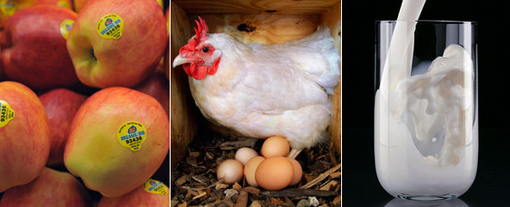
Are Organic Foods Safer or Healthier Than Conventional Alternatives?
Annals of Internal Medicine 2012; 157: 348-366

Slide 7
Current Organic Legislature
As of October 21, 2002, all foods bearing the USDA organic symbol must contain at least 95% organic ingredients.
Currently, the USDA makes no claims that organically produced food is safer or more nutritious than conventionally produced food.
Due to the complexity of the issue and the lack of well controlled research investigations, there is no national recommendation regarding consumption of organic foods.
Notes:
Between 1997 and 2010, U.S.sales of organicfoods increasedfrom $3.6 billion to 26.7 billion. Although prices vary, consumers can pay up to tice as much for organic than conventional foods.
Organic certification requirements and farming practices vary worldwide, but organic foods are generally grown without synthetic pesticides or fertilizers or routine use of antibiotics or growth hormones.
Organic livestock are fed organically produced fed that is free of pestices and animal by products are are provided access to the outdoors, direct sunlight, fresh air, and freedom of movement.
Organic regulations typical require that organic foods are processed without irradiation or chemical food additives and are not grown from genetically modified organism.
Or

Slide 8
Why Do Consumers Purchase Organic Foods?
Concerns about the effects of conventional farming practices on:
  The environment
  Human health
  Animal welfare
  Perceptions that organic foods are tastier than their conventional alternatives

Slide 9

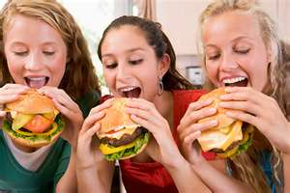
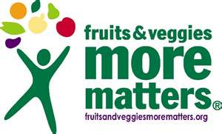
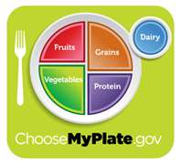
The Majority of Americans are not Meeting Current Recommendations for Fruit and Vegetable Consumption
Notes:
9
I don’t think we need to tell you that the Majority of Americans are not meeting recommendations for fruit and vegetable consumption. In fact, the CDC says it. So does the Produce for Better Health Foundation, although this group does report they have seen increases in some demongraphic groups, but in general, consumption of fruits and vegetables is flat and, by some reports, even declining. And now we have a new recommendation from the USDA that half of what people eat should be fruits and vegetables.

Slide 10
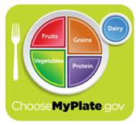
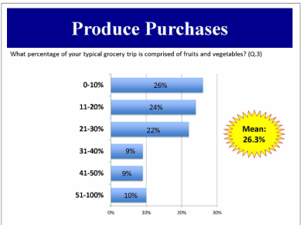
Fewer than 20 percent of Americans are meeting USDA recommendations!
Notes:
10
According to our the Alliance for Food and Farming’s own research, people are telling us they are not meeting this recommendation. In fact, we found that less than 20 percent of consumers are meeting the new recommendation from USDA that half of what they eat is fruits and vegetables. Infact the majority report that less than 20 percent of their diet consists of eating fruits and vegetables.

Slide 11
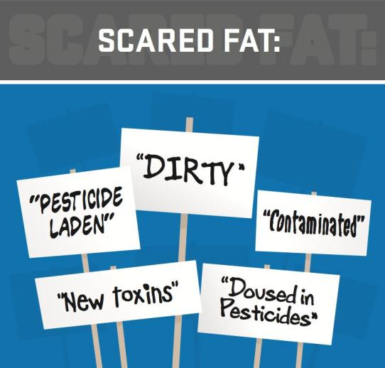
Are Consumers Being Scared Away from Healthy Foods?
Notes:
Are consumers being scared away from healthy foods? Yes, we believe they are.

Slide 12
Consumers Are Concerned About Pesticides!
Consumer Research:
How concerned are you about pesticide
residues on fruits and vegetables?
Are there any fruits or vegetables you have
stopped or reduced purchasing because of
concerns about pesticide residues?
Reference: Alliance for Food and Farming 2008
Notes:
12
For many years the Alliance for Food and Farming has conducted consumer research on a number of topics involving food safety to gauge consumer attitudes and perceptions. Back in 2008, we conducted a project which showed that. . . . (provide above survey results).

Slide 13
Other Key Findings
Why the Confusion?
Everyone agrees that consumers should be eating more fruits and vegetables.
Consumer research suggest the most credible people to deliver health messages to consumers are physicians, nutritionists and dietitians.
However, the popular media is increasingly where many get their nutritional facts
.
Mark Murai
President
California Strawberry Commission
Notes:
13

Slide 14
Regrettably, increasingly negative messaging is becoming accepted as factual.
“The growing consensus among scientists is that small doses of pesticides and other chemicals can cause lasting damage to human health, especially during fetal development and early childhood.”
Environmental Working Group
.
Notes:
14

Slide 15
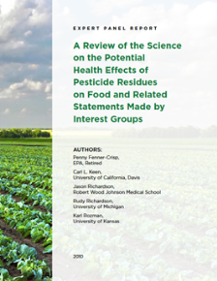
Report Findings
Lists like “dirty dozen” can be an impediment to good health because they can discourage consumption of produce.
The lists may mislead consumers.
They do not provide a basis to assess risk.
There is no scientific evidence
that the levels of pesticides found
on fruits and vegetables pose any human
health risk.
Notes:
15

Slide 16
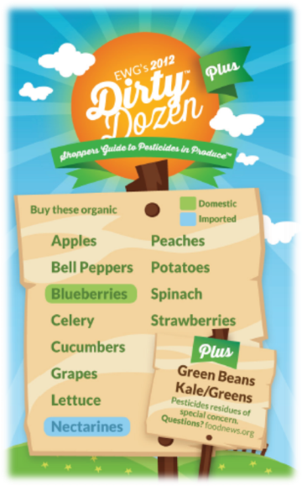
“Is the Produce You Eat Covered in
Pesticides?” --Chicagoist
“Terrifying Toxic Fruit List Will Change
the Way You Eat” --The Stir
“14 Pesticide-Covered Foods That Will
Change The Way You Shop”
--Business Insider
“Watch Out for the 2012 Dirty Dozen”
--CNN
Notes:
Just last month – as it has done for the past 10 years – an activist group known as the Environmental Working Group released its 2012 Dirty Dozen list. This year, they actuall expanded the list by two and called it the Dirty Dozen Plus. So now, we actually have 14 fruits and vegetables that have been identifed by this “non-profit watchdog group” because they claim the have high levels of pesticide residues and should be avoided unless you can find an organic version. Athough this may sound reasonable, we will show you today that it is far from that. But first, let’s take a look at the headlines this report generated in the media and on the internet. (read headlines). I don’t think anyone would disagree that these headlines ARE scary – and, that is exactly as intended.

Slide 17
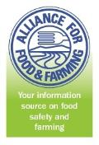
About the Alliance for Food and Farming
Non-profit formed in1989
Organic and conventional farmers. Alliance contributors are farmers of fruits and vegetables; companies that sell, market or ship produce; or organizations representing farmers.
Mission: to deliver credible information to consumers about the safety of fruits and vegetables.
The Alliance does not engage in any lobbying activities, nor does it accept any money or support from the pesticide industry.
Notes:
The latest report conducted by the Alliance for Food and Farming is the one we call Scared Fat. But before we get into that – let me tell you a bit about the Alliance for Food and Farming.

Slide 18
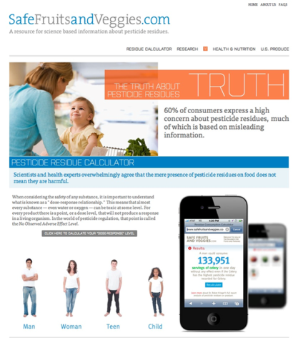
SafeFruitsandVeggies.com
Promotes consumption of all
fruits and vegetables.
Provides credible information
Developed by experts in nutrition,
toxicology, risk assessment and
farming.
Pesticide Residue Calculator
Farmer videos
Blog
Scientific Reports
Facebook, Twitter, YouTube
www.safefruitsandveggies.com
Notes:
Two years ago, our organization -- the Alliance for Food and Farming – which is funded by farmers of fruits and vegetables, both conventional and organic -- decided it had had enough of their healthy products being labeled “dirty.” And so, we launched a website at www.safefruitsandveggies.com. The site was created for one reason – to promote the consumption of all fruits and vegetables, whether they are organic or conventional. The site included information developed by experts in nutrition, toxicology, risk assessment and farming and includes user friendly devices, such as our pesticide residue calculator which is designed to show people how very small any pesticide residues found on fruits and vegetables really are. So small, in fact, that even a child could consume hundreds or even thousands of servings in one day and still not experience any health effects. The site also has videos of real farmers who grow both conventionalWe are doing this by providing more information about pesticide residues on fruits and vegeables because consumers are NOT getting the full story from media reports with headlines like I just showed you.

Slide 19
Scientific Basis of the “Dirty Dozen”
Risk = Exposure * Toxicity
The “Dirty Dozen” list considers exposure, but makes no attempt to address toxicity
There are reliable, well-established and accepted methods for assessing the risk of small doses of chemicals.
The authors of the “Dirty Dozen” list acknowledge this and clearly state on their website that the list “is not built on a complex assessment of pesticide risks.”

Slide 20
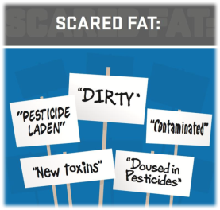
Scared Fat?
An Expert Panel reviewed a new nationwide study of 800 adults.
The survey examined the potential impact of negative messages by activist groups that question the safety of fruits and vegetables.
They considered the impact of this messaging on consumer attitudes toward buying fruits and vegetables.
Notes:
20
So, are people scared to eat healthy foods? I think we would all agree that fear is not the primary barrier when it comes to eating fruits and vegetables. We know there is a multitude of reasons why people are not eating more healthfully. But what impact – if any – do negative and scary messages about the safety of fruits and vegetables having on produce consumption. That is what we set out to determine. So, we brought in a team of five scientists in nutrition, consumer behavior and plant biology and we asked them to review a new study conducted among 800 adults across the US.

Slide 21
Expert Panel Conclusions
1. The survey results suggest an emerging public health threat. Negative messaging on food safety is not promoting consumption of fruits and vegetables.
2. We have an obesity epidemic. The Media/Internet may be increasing our fears about food safety, and lowering our faith in government oversight of the safety of our food.
3. It is inaccurate to suggest that organic produce is the only “safe” choice.
4. Some consumers feel like they are making inferior choices when they buy conventionally grown produce.
5. The key health message should be – eat your fruits and vegetables.
Notes:
21

Slide 22
What is the REAL Truth?
Is there scientific consensus that the small amounts of pesticide residues reported to occur on some food sources are harmful?
Is there evidence that the benefits of eating fruits and vegetables outweigh the potential risks associated with the small amounts of pesticides that might be obtained through the ingestion of these foods?
.
Notes:
22

Slide 23
Organic and
Conventional Produce
Whether grown organically or conventionally, plant foods contain:
Fiber
Vitamins
Minerals
Phytochemicals

Slide 24
Organic Advantages
Organic plant foods may have an advantage over conventionally grown foods by:
Having an increased concentration in:
  Vitamin C
  Carotenoids
  Polyphenols
Notes:
Dietary antioxidants, such as vitamin C and phenolic compounds, vitamin E and carotenoids contribute both to the first and second lines against oxidative stress.
Mitchell ( higher total phenoilics and Vitamin C in org strawberries, marionberries and sweet corn. Recently in tomatoe cultivars organic had higher phenolics, Vitamin C and quercetin. (not seen with bell peppers—not all affected equally)

Slide 25
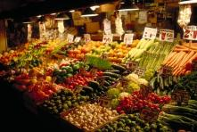
It is Well Accepted that Fruits and Vegetables are Good For You
No convincing evidence that pesticide residues on fruits and vegetables pose a risk to health.
In contrast, the data on health benefits of consuming fruits and vegetables is substantial and convincing.
Probable reductions in risk provided by diets rich in fruits and vegetables:
  ►High blood pressure ►Stroke ►Heart disease
  ►Some Cancers ►Digestive problems.

Slide 26

Remaining Uncertainties About Fruit and Vegetable Health Benefits
◆ The precise mechanisms that underlie the positive health effects of fruit and vegetables are still poorly understood and represent an area of significant research.
◆ Limiting one’s diet to certain fruits and vegetables, and excluding others, due to fears over pesticide residues, is risky.
  May result in individuals making questionable decisions regarding the known positive benefits of fruits and vegetables versus the theoretical negative effects of pesticide residues.

Slide 27
Potential Differences in Nutritional Quality of Conventional and Organically-Grown Foods?
Some recent analyses address this issue:
  Winters and Davis (2006) review for Institute of Food Technologists.
  Dangour et al. (2009) review from London School of Hygiene & Tropical Medicine.
  Smith-Spangler et. al. (2012) review from Annals of Internal Medicine
Some differences are expected between conventional and organically-grown foods.
  Conventional crops have more nitrogen available, often leading to more growth.
  Organic crops are often under more stress which can result in an increased production of defensive phytochemicals in plants.
  The nutritional value of these compounds for humans is poorly understood.

Slide 28
Potential Differences in Nutritional Quality of Conventional and Organically-Grown Foods?
Important nutritional differences between conventional and organically-grown fruits and vegetables were not identified in the above studies.

Slide 29
Are Organic Foods Safer or Healthier Than Conventional Alternatives?
No differences in vitamin or mineral content between conventionally and organically grown fruits and vegetables
  with the exception of phosphorus
No differences in protein or fat content in milk from conventionally and organically raised animals
  limited evidence for higher omega 3 fatty acids in milk from organically raised animals
Pesticide levels of organic and conventional foods fell within allowable safety limits
  lower levels of pesticide residues in urine of children consuming organic diets
Annals of Internal Medicine 2012; 157: 348-366

Slide 30
I Encourage You To . . .
Check out the website
  www.safefruitsandveggies.com
Sign up for the newsletter
Like” the Facebook Page
www.facebook.com/safefruitsandveggies

Slide 31

Study: High Fructose Corn Syrup Is No Worse Than 'Real' Sugar

Slide 32
“Added Sugar”
Definition came from USDA
  Added sugars are sugars and syrups added to foods in processing or preparation
Sugar not intrinsic to the food

Slide 33
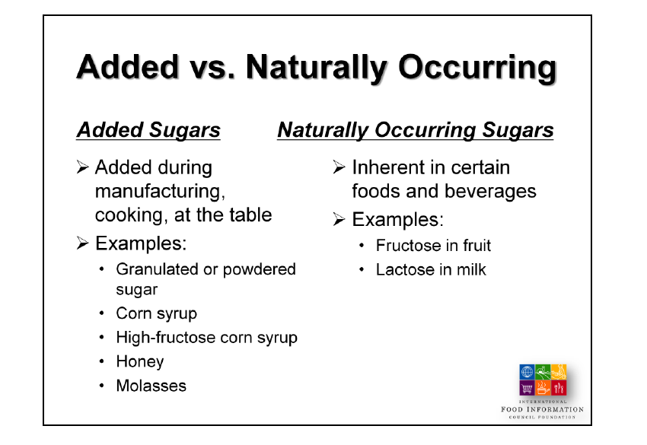

Slide 34
High Fructose Corn Syrup
High-fructose corn syrup is not pure fructose. There are two main types of high-fructose corn syrup that are used in foods:
55% fructose/ 45% glucose: this is mostly used in sugary drinks, like soda, as well as in ice cream and other frozen desserts
42% fructose/ 58% glucose: this is mostly used in baked goods, like cookies and crackers, and canned fruits, condiments, and dairy products

Slide 35
High Fructose Corn Syrup
Credible experts and scientific societies:
  “There is not a metabolic difference between high fructose corn syrup and sugar”
  Increased caloric intake, not a single sweetener is the likely cause of obesity

Slide 36
To discern whether a new scientific study is pertinent to HFCS
Experimental design: randomized controlled studies are the gold standard
Subjects tested: human subjects
Sugars compared: HFCS versus sugar is the best comparison
Levels tested: range of fructose in diet is 5-17% of kcals
  Be wary of studies that use exaggerated fructose levels in human (25-50% of kcals) and animals (>60% of kcals)
Notes:
Both sweeteners contain similar amounts of fructose and glucose
Sugar is often erroneously characterized as a safer sugar
Fructose versus glucose is a poor comparison

Slide 37
Recommendations for Intake of Added Sugars
American Heart Association
  <150 kcals/d for men (9 tsp)
  <100 kcals/d for women (6 tsp)
Dietary Guidelines for Americans (2010)
  As Solid Fats and Added Sugars (SoFAS)
    5-15% of total kcals

Slide 38
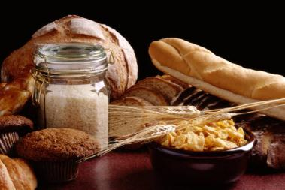
Gluten and Celiac Disease
Gluten is a protein found in:
  Wheat
  Rye
  Barley
  Oats
Provides bread with elasticity and chewiness

Slide 39
What is celiac disease?
An autoimmune disorder
Exposure to gluten results in damage to the intestinal lining
Damage to the lining of the intestine reduces ability to digest and absorb nutrients
Treatment consists of completely eliminating gluten from the diet
Notes:
Affects approximately 1% of the population
“long term compliance with a gluten free diet improves outcomes related to bone desnity, iron deficiency anemia, villous atrophy, gastrointestinal and neurological syumptoms, pregnancy outcomes, and quality of life
Obvious symptoms: diarrhea, weight loss and nutritional deficiencies. Mild clinical symptoms with non specific complaints include fatigue, headaches, and joint pain

Slide 40
Gluten-related Disorders
Celiac Disease
Wheat Allergy
Gluten Sensitivity
  Not diagnosed on allergic or autoimmune mechanisms
  Controversial
  Subject to risk of placebo effect
Notes:
GS: in addition to CD symptoms: behavioral changes, bone or joint pain, muscle cramps, leg numbness, weight loss and chronic fatigue

Slide 41
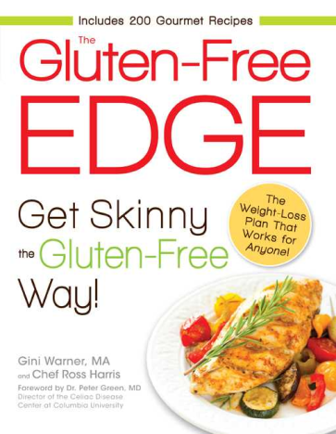
Gluten-Free Diets
Important for individuals with celiac disease
Newest health fad
  Claims of more energy, weight loss, etc
  Very little research available to support or disprove claims
Notes:
Typical intake of 10 to 20 grams per day

Slide 42

Downsides to Gluten-Free Diet
Expense
  Gluten-free products can be twice as expensive as gluten-containing products
May be low in certain nutrients
  Iron, folate, niacin, zinc, and fiber
May be higher in calories
Notes:
Claims of the potential benefits of following a gluten-free diet include better sleep, increased energy, thinner thighs, faster weight loss, clearer skin, and improvement of medicl conditions such as autism and rheumatoid arthritis. Estimated the US market for gluten-free foods and beverages at 2.6 billion dollars in 2010 and by 2015 expected to exceed 5 billion dollars.
Number one motivators: perceived as healthier!!!!!!!!!American Dietetic Association. Evidence-Based Nutrition Practice
Guideline on Celiac Disease. May 2009. American Dietetic Association
Evidence Analysis Library Web site. http://www.adaevidencelibrary.
com/topic.cfm?cat3726.

Slide 43


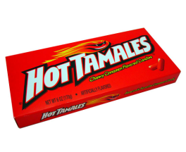

“Have Your Gluten-Free Candy This Halloween and Eat It Too”

Slide 44
Food and Nutrition Misinformation
Consumers are increasingly taking charge of their self-care.
  Positive in that sound nutrition can play an important part in one’s life
  Negative in that it makes people more vulnerable to food and nutrition misinformation that can impact their health and economic well-being
    Nutrition misinformation can lead consumers to lose faith in traditional sources of nutrition information and pay less attention to results of new findings

Slide 45
Accurate Food And Nutrition Information
    Is a result of significant scientific agreement from studies that have withstood peer review
    Is a result of studies that have been replicated

Slide 46
Concluding Statements
It is our responsibility as nutrition scientists and educators to act as credible sources of science-based nutrition recommendations.
We must work to prevent the attitude:
“Just eat whatever the heck you want. One day something’s bad for you, one day it’s good for you. Maybe I’ll get lucky and smoking will be good for me too.”

Slide 47
EVALUATING INFORMATION YOU FIND ONLINE
Food and Nutrition Information Center
  http://fnic.nal.usda.gov
    Consumer corner
    Eating for health
    On-line health information
  Evaluating Health Information on the Internet
  Evaluating Internet Health Information: A Tutorial from the National Library of Medicine
  Online Health Information: Should You Believe What you See?
  Tips for Healthy Surfing Online
Nutrition and Health Search Engines
  Healthfinder.gov
  MEDLINEplus Health Information
  Health Information-National Institutes of Health

Slide 48
Websites with Reliable Nutrition and Health Information
American Dietetic Association http://www.eatright.org
National Institutes of Health http://www.nih.gov
Food and Drug Administration http://www.fda.gov
Centers for Disease Control and Prevention http://www.cdc.gov

Slide 49
More Websites with Reliable Nutrition and Health Information (continued)
American Council on Science and Health http://www.acsh.org
Quackwatch
http://www.quackwatch.org
National Council Against Health Fraud
http://www.ncahf.org

Slide 50
UC Davis
Department of Nutrition
Nutrition Information
http://nutrition.ucdavis.edu
http://chnr.ucdavis.edu

