Slide 1
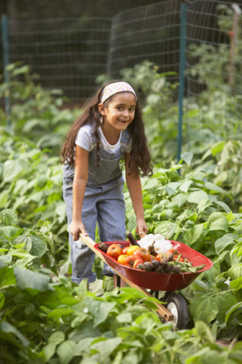
Improving Children’s Nutrition and Health Through School-Based Agriculture Programs
Sheri Zidenberg-Cherr, PhD
Cooperative Extension Specialist
Center for Nutrition in Schools
Department of Nutrition
University of California, Davis
CSU Fullerton NCW Sept 2012

Slide 2
Outline
Current Health Trends of Children
Garden-based Nutrition Education
Farm to School Programs
Multicomponent School-Based Nutrition and Agriculture Programs

Slide 3
Health Trends
Children (2-19 years of age)
Children’s diets do not meet national US recommendations
Desirable physical activity levels are not being met
Obesity rates are increasing
  Approximately 17% (or 12.5 million) of children and adolescents aged 2—19 years are obese.
Adult diseases are showing up in children
Notes:
Diets don’t meet goals:
Only 2% of children meet recommendations of MyPyramid/MyPlate
Less than 15% of school children eat recommended servings of fruit and vegetables
Only 30% consume recommended milk group servings
Teens drink twice as much soda a s milk
Nearly half of 12-21 year olds do not engage in regular physical activity
Childhood obesity is a national epidemic: 4.7 million children aged 6-17 are currently overweight or obese
30,000 children have Type 2 diabetes, a type of diabetes that was once almost entirely limited to adults

Slide 4
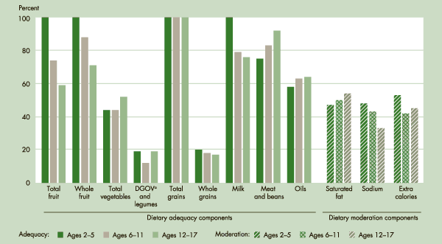
Health Trends
Children (2-19 years of age)
Children’s diets do not meet national US recommendations
INDICATOR HEALTH6: AVERAGE DIET SCORES FOR CHILDREN AGES 2–17, EXPRESSED AS A PERCENTAGE OF FEDERAL DIET QUALITY STANDARDS, BY AGE GROUP, 2007–2008
Notes:
SOURCE: National Center for Health Statistics, National Health and Nutrition Examination Survey, 2007–2008 and U.S. Department of Agriculture, Center for Nutrition Policy and Promotion MyPyramid Equivalents Database 2007–2008 (preliminary).
Diets don’t meet goals:
Only 2% of children meet recommendations of MyPyramid/MyPlate
Less than 15% of school children eat recommended servings of fruit and vegetables
Only 30% consume recommended milk group servings
Teens drink twice as much soda a s milk
Nearly half of 12-21 year olds do not engage in regular physical activity
Childhood obesity is a national epidemic: 4.7 million children aged 6-17 are currently overweight or obese
30,000 children have Type 2 diabetes, a type of diabetes that was once almost entirely limited to adults

Slide 5

Health Trends
Children (2-19 years of age)
Desirable physical activity levels are not being met
  <40% meet current physical activity recommendations
Youth Risk Behavior Surveillance System (YRBSS; http://www.cdc.gov/HealthyYouth/yrbs/), National Health and Nutrition Examination Survey (NHANES; http://www.cdc.gov/nchs/nhanes.htm), and the National Health Interview Survey (NHIS; http://www.cdc.gov/nchs/nhis.htm).
Notes:
The major national public health surveillance systems monitoring physical activity in the US population include the Behavioral Risk Factor Surveillance System (BRFSS; http://www.cdc.gov/brfss/), the Youth Risk Behavior Surveillance System (YRBSS; http://www.cdc.gov/HealthyYouth/yrbs/), National Health and Nutrition Examination Survey (NHANES; http://www.cdc.gov/nchs/nhanes.htm), and the National Health Interview Survey (NHIS; http://www.cdc.gov/nchs/nhis.htm).

Slide 6
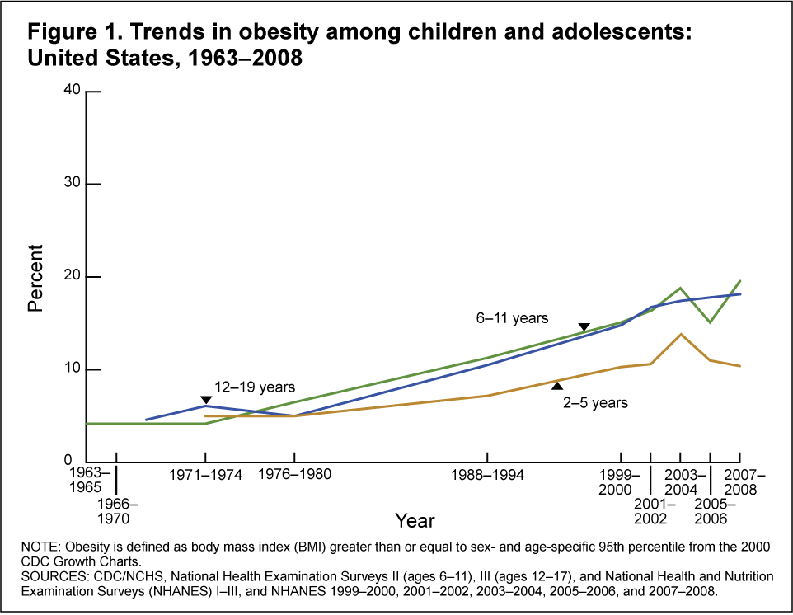
Health Trends
Children (2-19 years of age)
Notes:
Diets don’t meet goals:
Only 2% of children meet recommendations of MyPyramid/MyPlate
Less than 15% of school children eat recommended servings of fruit and vegetables
Only 30% consume recommended milk group servings
Teens drink twice as much soda a s milk
Nearly half of 12-21 year olds do not engage in regular physical activity
Childhood obesity is a national epidemic: 4.7 million children aged 6-17 are currently overweight or obese
30,000 children have Type 2 diabetes, a type of diabetes that was once almost entirely limited to adults

Slide 7

What can be done?
The school setting is an ideal place for creating a healthy environment that supports physical activity and nutritious dietary habits.

Slide 8
Why schools? Why gardens?
Today’s children lack an understanding of the impact farming has on their lives.
The incorporation of agriculture into the school environment and classroom curriculum can provide an avenue in which to discuss the importance of a healthy diet while creating a school environment that promotes healthy behaviors.

Slide 9
History of School Gardens
Originated in Europe
Arrived in US in the 1890s
Increase in numbers in early 20th century
Decrease in numbers in 1950s
Recent surge in popularity

Slide 10
School-based nutrition, health and and agriculture programs
It is imperative to investigate creative and effective healthful eating initiatives
Schools can provide a hub for networking with
  Families
  Health partners
  Agricultural community
  Other community members

Slide 11
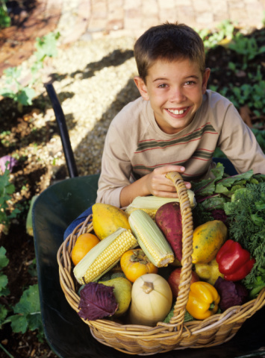
Garden-Enhanced Nutrition Education:
Nutrition To Grow On (NTGO)
Objective: To develop a curriculum designed to improve the nutrition knowledge and vegetable preferences of
upper-elementary school children.
Morris, J.L., and Zidenberg-Cherr, S. Garden-Enhanced Nutrition Curriculum Improves Fourth-Grade School Children's Knowledge of Nutrition and Preferences for Some Vegetables, JADA 102(1): 91 - 93
Notes:
Given that today’s children lack an understanding of the impact farming has on their lives.—our group began this work over a decade ago. Worked with California Department of Agriculture during DelaineEastin’s “ A Garden in Every School”. At that time, at least to our knowledge there were no tested curricula available that provided nutrition and garden lessons for K-6 students. So our doctoral student, Jennifer Morris, began this endeavor for her doctoral thesis. The Committee on Progress in Preventing Childhood Obesity in 2007 cited nutrition education and gardening as an example of promising, innovative, programming to increase fruits and vegetables through farm to school programs and school gardens.
Based on our pilot study results, our next objective was to develop a more comprehensive nutrition education curriculum designed to improve the nutrition knowledge and vegetable preferences of upper-elementary school-aged children.
This objective was broken down into two phases. The initial phase consisted of the development and pilot testing of both the curriculum and the assessment tools.
The final phase consisted of a formal evaluation of the curriculum using the tested assessment tools.

Slide 12
Nutrition to Grow On: Content
Lesson Topics
  Plant Parts Physical Activity
  Nutrients Goal Setting
  Food Guide Pyramid Consumerism
  Servings Sizes Snack Preparation
  Food Label
Gardening Component
  Linked to Each Topic
  In-class Discussion
  Hands-on Activity
Notes:
Nine lessons were developed covering such topics as plant parts, nutrients, the Food Guide Pyramid, serving sizes, the food label, physical activity, goal setting, consumerism, and snack preparation.
The gardening component was incorporated into each lesson in two ways. First, a related gardening topic was discussed in class during each nutrition lesson. For example, during the lesson on consumerism, the students learned how companies advertise for our business while plants advertise to attract insects.
Second, a separate hands-on gardening activity was added to each lesson.

Slide 13
Garden Enhanced Nutrition Education
Control
Site
Classroom-Based
Nutrition Education
Garden-Based
Nutrition Education
Pre-test Data Collection (n=215)
CONTROL
CBNE
Intervention
GBNE
Intervention
Post-test Data Collection (n=205)
6-month Follow-up Data Collection (n=198)
Notes:
Once the curriculum and assessment tools had been developed, the formal evaluation of the curriculum began.
Three schools, with similar demographic make-up, were selected from a local school district to participate in the study. One school was chosen as the control site, designated as CONT,and received no formal nutrition or gardening education. Another school was chosen as the classroom-based nutrition education site, designated as CBNE, and received only the in-class nutrition lessons. The third school was chosen to be the garden-based nutrition education site, designated as GBNE, and received the in-class nutrition lessons as well as the additional hands-on gardening activities. Three fourth grade classrooms participated at each site.
Pretest data was collected from a total of 215 students using both the previously tested nutrition knowledge questionnaire and the vegetable preference survey.
The intervention phase of the study began following the students’ winter break. The control site intervention consisted of the investigator’s presence during class time when subjects other than health or nutrition were taught. The CB intervention consisted of exposing the students to only the in-class nutrition lessons. The GB intervention consisted of exposing the students to both the in-class nutrition lessons as well as the hands-on gardening activities.
The nine lessons were taught at the two intervention sites every other week for 17 weeks so as to span the growing cycle of the vegetables planted at the GB site. Newsletters were sent home to students’ families on the weeks in-between lessons to reinforce concepts taught in class and provoke family discussion.
The post-test data was collected from 205 students following completion of the lessons. Follow-up data was collected 6-months later.

Slide 14
Mean nutrition knowledge score *
30
CONT
CBNE
GBNE
25
b
b
b
b
20
a
Adjusted mean score (SE) (max. = 30)
a
15
10
5
0
Post-Test
Follow-up
* Means are adjusted for pre-test values. Means with a superscript in common within each time point are not significantly different (p < 0.01).
Notes:
This slide shows the mean nutrition knowledge scores for all three sites at the time of post test and 6-month follow-up. As shown on the y-axis, the maximum score was 30 points, and all scores were adjusted for pre-test values. There were no significant differences between the three groups at the time of pre-test. In this and subsequent slides, the control group is shown in the hatched yellow bars, the CB group in striped pink bars, and the GB in solid blue bars.
As indicated by the different super scripts within each time point, students in the CB and GB groups scored significantly higher than the students in the CONT group immediately following the intervention. This difference was still significant at the time of the 6-month follow-up.
We did not expect to see any difference between the two intervention sites because both were provided with the same nutrition information.

Slide 15
Students’ preferences for vegetables immediately following intervention*
5
b
b
CONT
CBNE
GBNE
a
b
b
a
4
b
b
a
a
Adjusted mean vegetable preference (± SE)**
a
a
a
a
a
a
a
a
3
2
1
Carrot
Broccoli
Spinach
Snow Pea
Zucchini
Jicama
Vegetable
* Mean scores are adjusted for pretest values. Means with a superscript in common within each vegetable are not significantly different (p < 0.01).
** 5 = I really liked it a lot; 4 = I liked it; 3 = It was OK; 2 = I did not like it; 1 = I really did not like it.
Notes:
One of the questions on the vegetable preference survey asked the students to rate their preference of those vegetables which they tasted on a five point scale. In contrast with the pilot study, there were no significant differences in the students’ willingness to taste any of the vegetables. On average, students tasted the vegetables 85-95 % of the time.
In this and the following slide, vegetables are listed on the x-axis, and adjusted mean preference scores are listed on the y-axis. Scores have been adjusted for pre-test values.
This slide shows the preference data immediately following the intervention.

Slide 16
Students’ preferences for vegetables six months after intervention*
5
b
ab
CONT
CBNE
GBNE
a
b
b
a
4
ab
b
Adjusted mean vegetable preference (± SE)**
a
a
a
a
a
a
a
a
a
a
3
2
1
Carrot
Broccoli
Spinach
Snow Pea
Zucchini
Jicama
Vegetable
* Mean scores are adjusted for pretest values. Means with a superscript in common within each vegetable are not significantly different (p < 0.05).
** 5 = I really liked it a lot; 4 = I liked it; 3 = It was OK; 2 = I did not like it; 1 = I really did not like it.
Notes:
This slide shows the same data but at the time of the six month follow-up.

Slide 17
Students’ willingness to ask a family member to buy vegetables *
6
CONT
CBNE
GBNE
5
4
Adjusted mean score (SE) (max. = 6)
3
b
ab
a
a
a
a
2
1
0
Post-Test
Follow-up
* Means are adjusted for pre-test values. Means with a superscript in common within each time point are not significantly different (p < 0.005).

Slide 18
Students’ willingness to eat vegetables as a snack *
6
CONT
CBNE
GBNE
5
4
Adjusted mean score (SE) (max. = 6)
3
b
b
ab
ab
2
a
a
1
0
Post-Test
Follow-up
* Means are adjusted for pre-test values. Means with a superscript in common within each time point are not significantly different (p < 0.01).

Slide 19
NTGO: Conclusions
This garden-enhanced nutrition education program is effective at improving fourth graders’:
  Nutrition knowledge
  Preferences for vegetables
  Willingness to ask family to buy vegetables
  Willingness to eat vegetables as a snack
Notes:
In conclusion, our results show that this garden-enhanced nutrition education curriculum is an effective tool for improving the nutrition knowledge and vegetable preferences of school-aged children.

Slide 20

Nutrition To Grow On:
A Garden Enhanced Nutrition Education Curriculum for Upper-Elementary Schoolchildren
(CDE Press, 2001, 2012)
http://cns.ucdavis.edu

Slide 21
Research to Build On
Select garden-enhanced education programs are effective at improving students’:
  Nutrition knowledge¹
  Consumption of vegetables ^{3, 4}
  Preferences for vegetables ¹
  Willingness to ask family to buy vegetables ¹
  Willingness to eat vegetables as a snack ¹
Morris, J.L. and S. Zidenberg-Cherr. (2002). "Garden-enhanced nutrition curriculum improves fourth-grade school children's knowledge of nutrition and preferences for some vegetables." J Am Diet Assoc. 102: 91-93.
McAleese, J.D. and L.L. Rankin. (2007). "Garden-based nutrition education affects fruit and vegetable consumption in sixth-grade adolescents." J Am Diet Assoc. 107: 662-665.
Ratliffe et al (2011). “The effects of school garden experiences on middle school-aged students knowledge, attitudes, and behaviors associated with vegetable consumption. Health Promotion and Practice 12: 36-43.

Slide 22
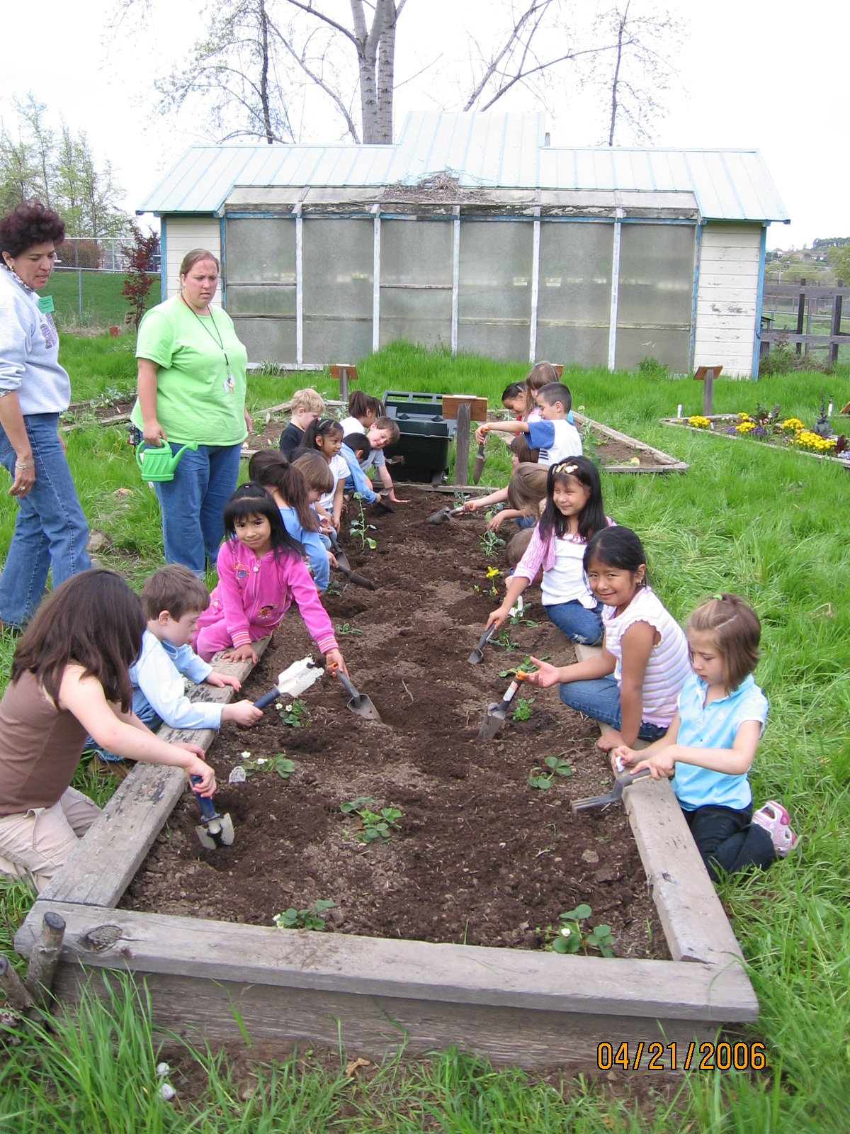
School Gardens
Engaging environment for use in comprehensive school health programs
Enhanced communication among students, families and their community
Link schools with families and communities to promote healthy lifestyle and prevent disease

Slide 23
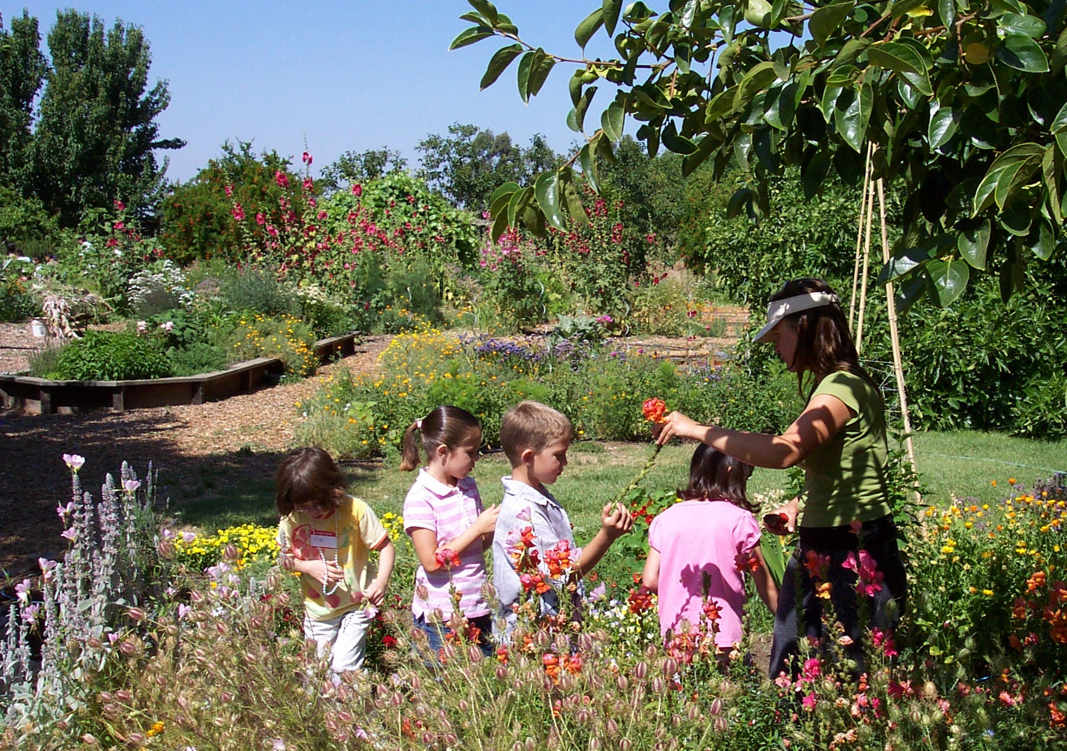
School Gardens: Benefits for Children
Academic Achievement
Health and Nutrition Education
Environmental Stewardship
Community and Social Development

Slide 24
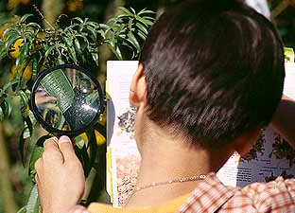
Significantly Higher Scores,
Science Achievement Tests
Lieberman & Hoody. (1998). “Closing the Achievement Gap”
C.D. Klemmer, Waliczek & Zajicek. (2005). Temple, Texas study of science achievement (647 students, Gr. 3-5) “Compared conventional science delivery to science with garden-based learning”
Smith & Motsenbocker. (2005). Inner city low income public school in Baton Rouge, LA “Used hands-on gardening activities with experimental group vs. none with control group”

Slide 25
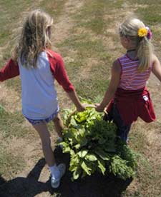
Personal and Social Development
Texas Master Gardener classroom garden project showed improvement in:
    Self-esteem
    Sense of ownership and responsibility
    Family relationships
    Parental involvement
Alexander, J., and D. Hendren. (1998). Bexar County Master Gardener Classroom Garden Research Project: Final Report. San Antonio, Texas.

Slide 26
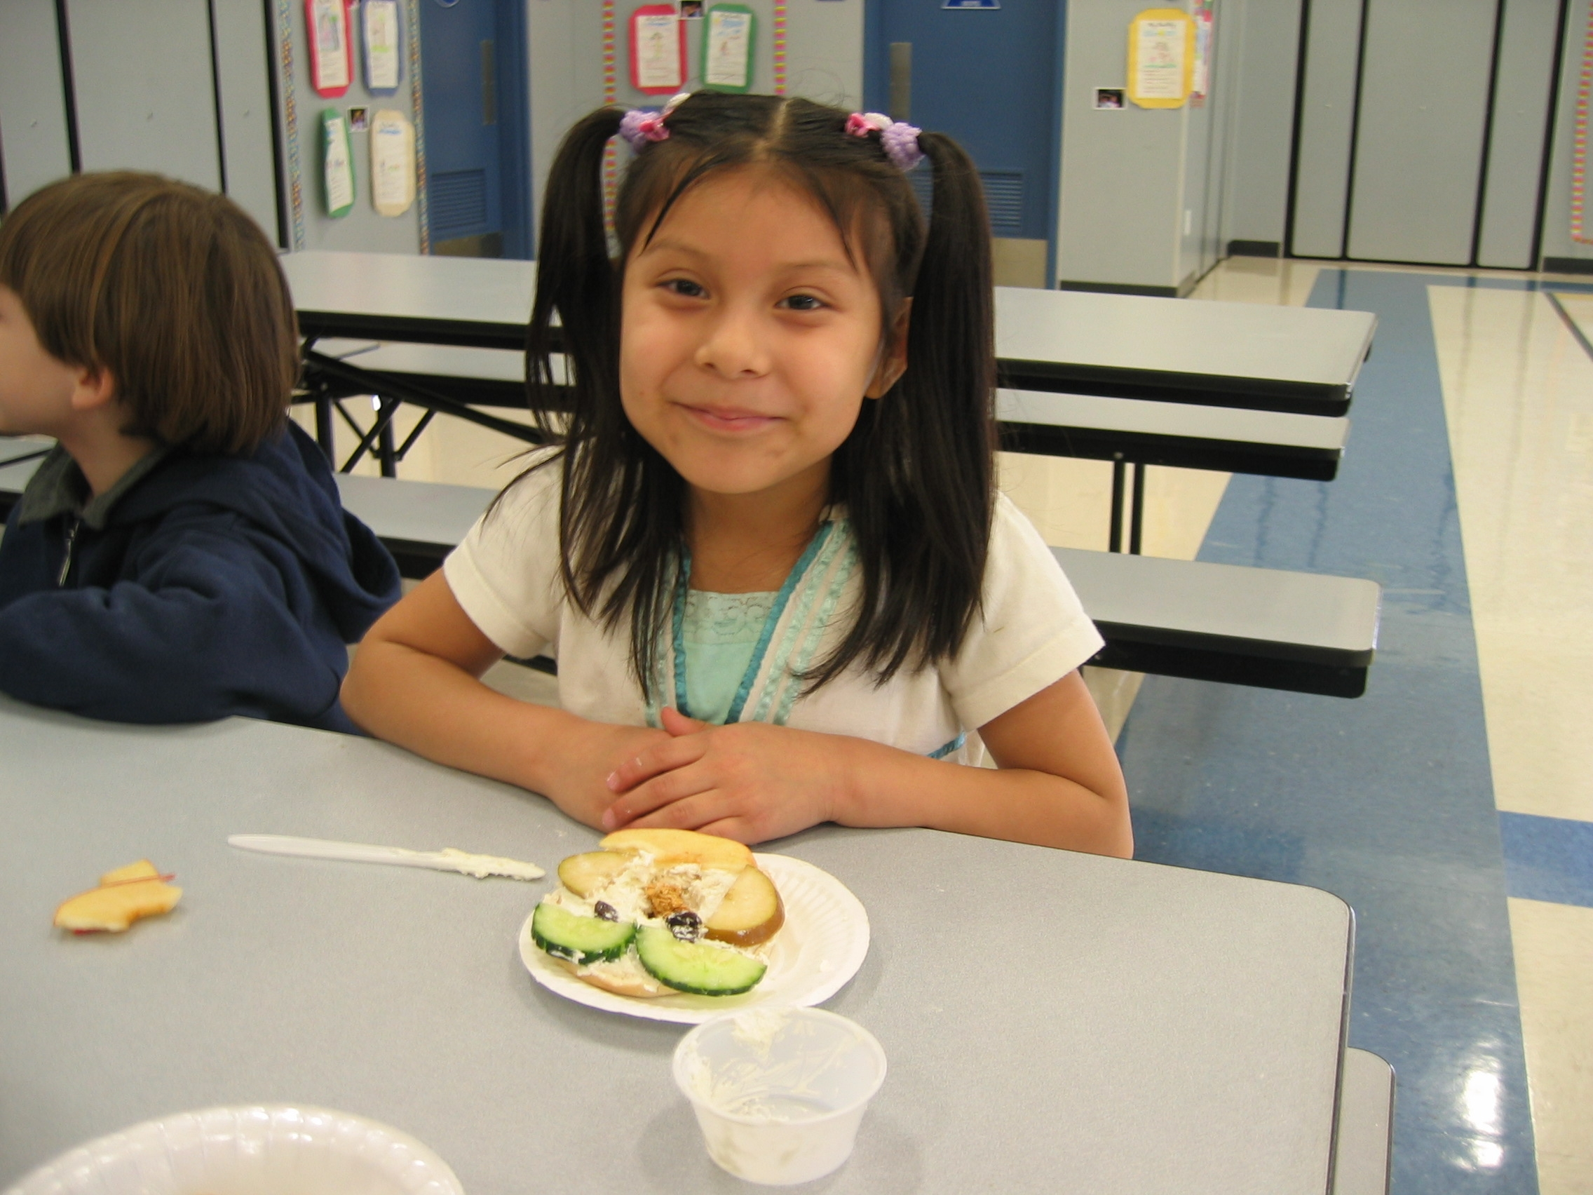
Improving Children’s Health through Farming, Food and Fitness
The CHF3 program:
  Established salad bars
  Incorporated nutrition education into classroom lessons
  Created a garden
  Developed a food waste composting system
Heneman, K., Junge, S.K., Schneider, C., Zidenberg-Cherr, S. Pilot Implementation of the Improving Children’s Health through Farming, Food, and Fitness program in select California schools. Journal of Child Nutrition and Management.; 32 (1).

Slide 27
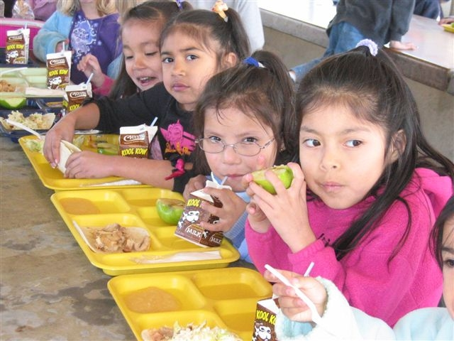
Improving Children’s Health through Farming, Food and Fitness
Children at both Rock Creek and American Union Elementary Schools increased their nutrition knowledge.
Heneman, K., Junge, S.K., Schneider, C., Zidenberg-Cherr, S. Pilot Implementation of the Improving Children’s Health through Farming, Food, and Fitness program in select California schools. Journal of Child Nutrition and Management.; 32 (1).

Slide 28
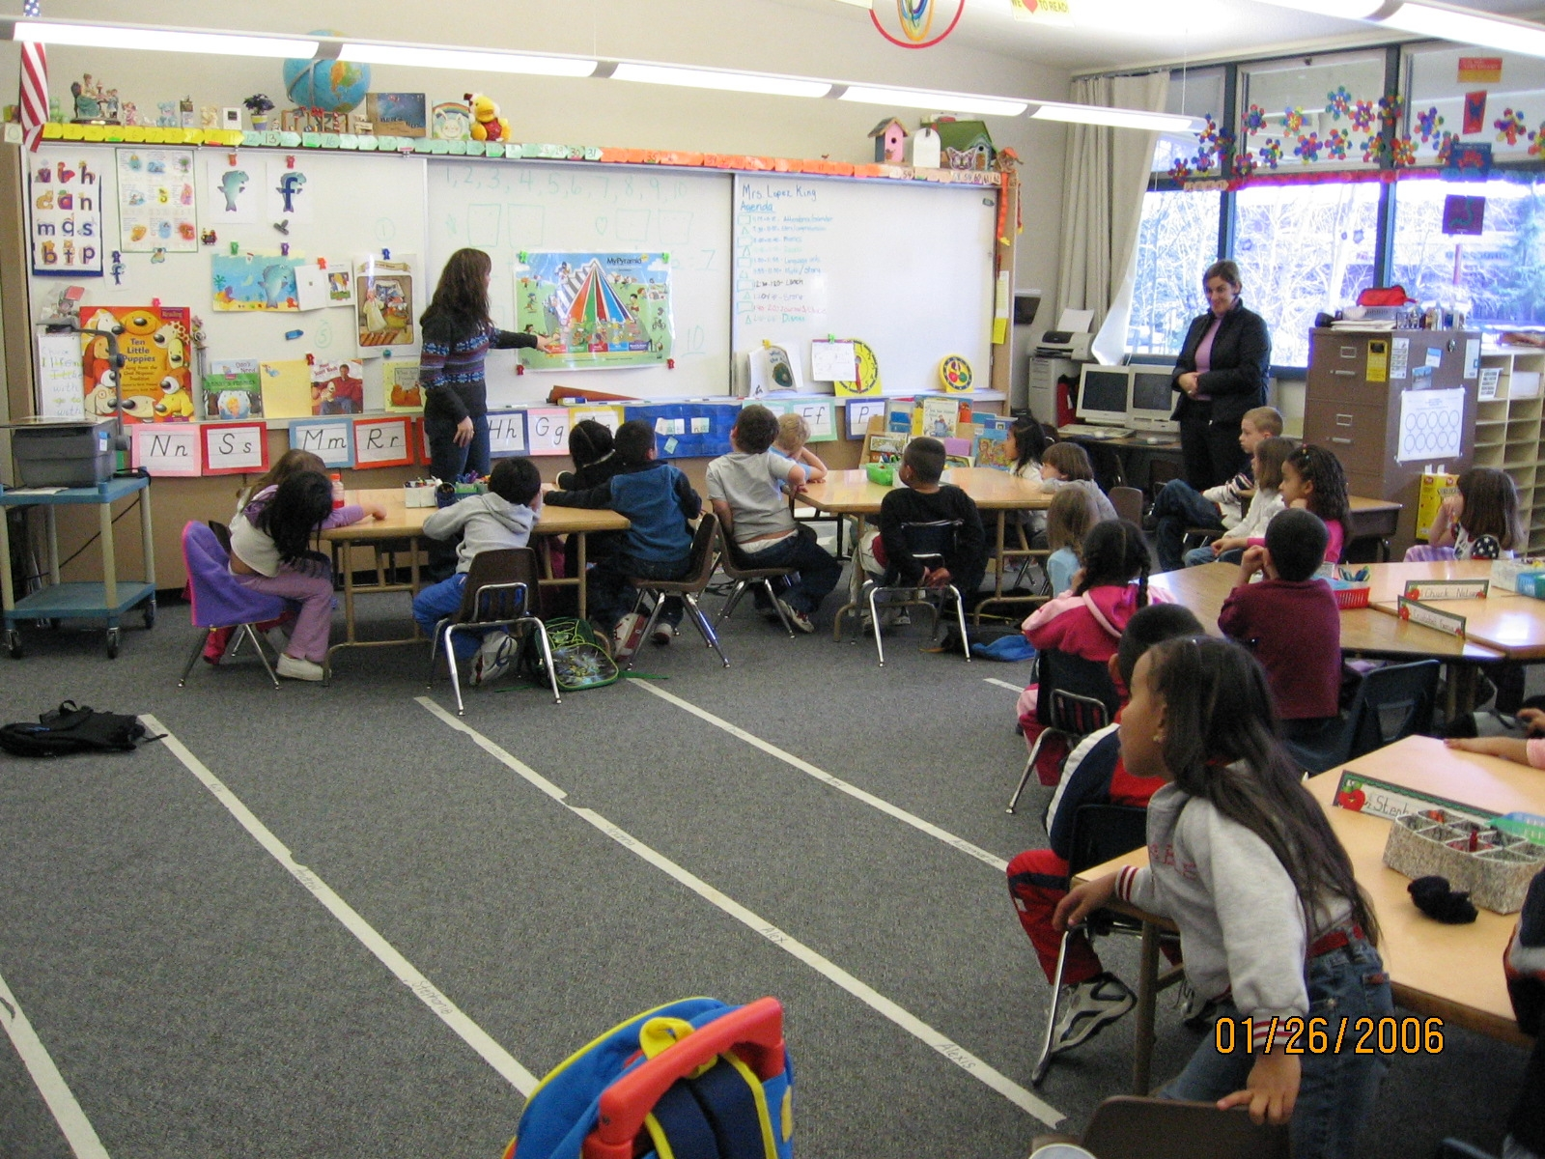
Pilot Study Results
Quotes from the school staff…..
The CHF3 program is “opening a window for the children.”
Students participating in the program “like the new veggies and fruit each week and all are trying things for the first time and learning so much.”
Students “now realize how important it is to be active, eat healthy, and learn about the food we eat.”

Slide 29
Improving Children’s Health through Farming, Food and Fitness
School | Finding | Significance
Rock Creek Elementary School | Decreased soda consumption | P= 0.041 60% pre vs. 35% post
Rock Creek Elementary School | Decreased computer use | P= 0.011 0.81 hrs pre vs. 0.33 hrs post
American Union Elementary School | Increase consumption of fruit | P= 0.044 88% pre vs. 97% post
American Union Elementary School | Decreased consumption of cookies | P= 0.00 88% pre vs. 56% post
Heneman, K., Junge, S.K., Schneider, C., Zidenberg-Cherr, S. Pilot Implementation of the Improving Children’s Health through Farming, Food, and Fitness program in select California schools. Journal of Child Nutrition and Management.; 32 (1).

Slide 30
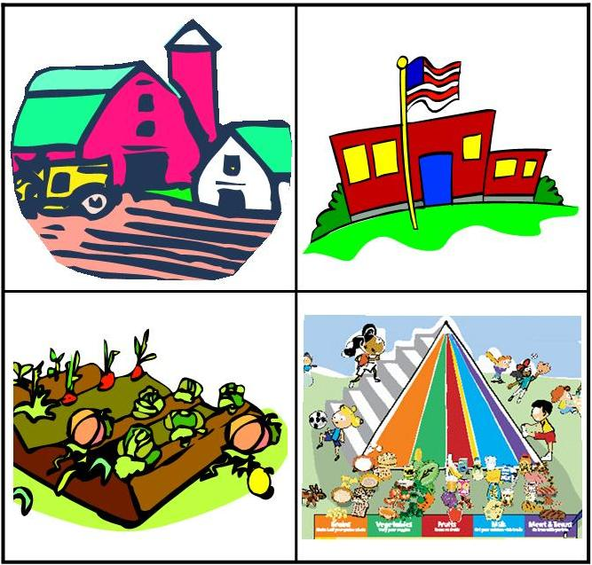
Eating Healthy From Farm to Fork
Garden Enhanced Nutrition Education for Kindergarten, 1st and 2nd grade
Notes:
In collaboration with UCCE Placer/Nevada counties,

Slide 31
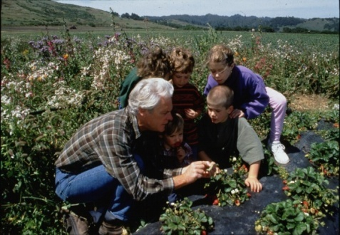
Farm to School
Any programming that connects schools (K-12) and local farms with the objective of serving local and healthy foods in school cafeterias or classrooms.
Common goals:
Improving student nutrition
Providing agricultural, health and nutrition education opportunities
Supporting small and mid-sized local and regional farms
Notes:
Farm to school, born through a small group of piulot projects in Acalifornia and Florida in the late 1990s now has a presence in all 50 states, totaling more than 2000 programs in 2010. The dramatic increase in the number and visibility of F2S can likely be attributed to a number of factors that include heightened public attention regarding childhool obesity, regional procurement practices, concerns related to environmental and ag issues and concenrns regarding the sustainability of the US Food system.

Slide 32
Farm to School
School foods are purchased directly from farmers
Experiential learning opportunities are provided, such as
  farm visits, gardening and recycling programs;
Farmers participate in programs to educate children about
  the food system,
  agriculture, and
  local foods.
Notes:
You came here today to learn more about farm to school programs and perhaps how to get involved. So I wanted to briefly mention Farm to School. In the next talk you will be hearing from Dr. Gail Feenstra who is a Food Systems Analyst with SAREP (UC Sustainable Agriculture Research and Education Program in the Agricultural Sustainability Instititute at UC Davis. She has just recently published a review on Farm to School so I will just touch on some overarching themes and nutrition-related findings pertaining to Farm to School programs.

Slide 33
Farm to School:
Evaluation
“Do Farm-to School Programs Make a Difference? Findings and Future Research Needs”
  Anupama Joshi, Andrea Misako Azuma, and Gail Feenstra, J Hunger and Environmental Nutrition 3: 229-246; 2008
Notes:
A relative recent review on Farm to school evaluation was published in 2008.

Slide 34
Farm to School:
Evaluation
Farm to School programs are increasing in number across the US yet evaluations published in peer-reviewed journals are limited.
    Fruit and vegetable consumption from salad bar
    School lunch participation
    Student knowledge and attitudes
    Food service behaviors
    Farmer behaviors
    Parent behaviors
“Further evaluation and research are needed to improve practice and assist programs in meeting their goals”
Notes:
Some outcomes measured in a few studies include those bulleted above. However, only 1 has been published in peer reviewed journals, the rest have been through reports without consistent methods,, measurements, and interpretations. While there are suggestions of benefits with respect to nutrition and agricultural practice knowledge, dietary behavior it has been stated repreatedly that further research is needed….

Slide 35
Farm to School: Evaluation
  Willamette Farm and Food Coalition (WFFC)
  Springfield School District, Oregon
  Integrated educational activities
  HOM
  Farm field trips
  Garden sessions
  Nutrition lessons
  Tasting tables
  Harvest days
www.farmtoschool.org
Notes:
In the next few slides I will present some brief evaluations provided on the national farm to school website. These show promise and these programs should be implemented using a experimental design controlling for outside factors that could influence outcomes. First and foremost, pre- and post- tests should be conducted using tested assessment tools.

Slide 36
Farm to School: Evaluation
  Willamette Farm and Food Coalition (WFFC)
  Springfield School District, Oregon
  Results (not published):
  Student’s fruit consumption increased > 0.5 servings per day
  Student showed an increase in knowledge about Oregon-grown foods and agricultural processes
  Perspectives of educators and farmers shared for future projects
www.farmtoschool.org

Slide 37
Farm to School: Evaluation
  Riverside Unified School District, California
  Schools received salad bars without any educational activities
  “Salad bar eaters” consumed 2 times more fruit servings and 1.66 times more vegetable servings than hot bar eaters
  Program created a stable market for produce grown by relatively small farmers
  Program facilitated the formation of a farmer cooperative, supporting a more regional food system
www.farmtoschool.org
Notes:
In Riverside California, the major component of the program was a Farmer’s Market Salad Bar, a daily salad bar stocked with produce provided by local farmers, and offered year-roud as an alternative to the hot lunch meal.

Slide 38
What Are the Potential Benefits?
Children start the habit of eating more fresh, locally-produced food early in life, especially when their eating is supported by food and farm education activities including gardening;
Farmers develop new markets with often higher returns for their goods; and
Communities gain understanding of the importance of local agriculture, environmental protection, and farmland conservation.

Slide 39

Farm to School: Opportunity for
Collaboration
Dietitian
School Nutrition
Professionals
Environmental
Educator
Parent:
Food Culture
Specialist
Farmer
Community/
Seniors
Teacher
Master
Gardener
Agriculture
Educator
Master
Composter
Notes:
Hopefully it is clear that Farm to School provides an excellent opportunity for collaboration across many facets of education, community and health

Slide 40

Shaping Healthy Choices Program (SHCP)
UC Davis
Department of Nutrition
Department of Human and Community Development
Agricultural Sustainability Institute
Foods for Health Institute
School of Veterinary Medicine
School of Nursing
UCCE
Alameda, Butte, Amador/Calaveras, Merced/Stanislaus, Shasta, Sacramento

Slide 41
The Shaping Healthy Choices Program
School Wellness Policy
Objectives:
Increase availability, consumption, and enjoyment of fruits and vegetables;
Improve dietary and exercise patterns;
Improve critical thinking skills;
Promote positive changes in the school environment;
Facilitate development of an infrastructure to sustain the program
Nutrition Education & Promotion
Family & Community Partnerships
Sustainable Student Outcomes
Foods Available on the School Campus
Supporting Regional Agriculture
School Wellness Policy

Slide 42
Shaping Healthy Choices Program
Component 1:
  Nutrition Education and Promotion
    Classroom education
      Curriculum development-inquiry based (NTGO)
      School garden
      Healthy cooking demonstrations
      Physical Activity
      Science (Critical thinking skills)

Slide 43
Shaping Healthy Choices Program
Component 2:
  Family and Community Partnerships
    Family newsletters
    School wellness policy leaders
    Parent and community volunteers
    Physical activity events
    Out-of-school programs (4H)
    Health promotion activities

Slide 44
Shaping Healthy Choices Program
Component 3:
  Supporting regional agriculture
    Procurement strategies developed
      Plans developed between school nutrition program (SNP) directors/regional distributors/local farmers
    Professional development for SNP personnel
      Enhance integration of school meals, nutrition education, school gardens and classroom lessons
      Trainings on culinary techniques and flavor development strategies; menu descriptors that make vegetables more appealing

Slide 45
Shaping Healthy Choices Program
Component 4:
  Foods available on campus
    Classroom cooking demonstrations linked with SNP
    Salad bars
      Regional growers
      School gardens

Slide 46
Shaping Healthy Choices Program
Component 5:
  School wellness policy
    Meet with school wellness advisory committee
      Needs assessment to identify gaps in achieving stated goals and methods to address each concern
      Evaluation by SCAN rubric

Slide 47
Evaluation
Process evaluation
  Work in partnership to develop a “how to” manual
    ie. Component 3: guide of “Food Hubs” available to local sites
  Continual monitoring of program plan
Impact evaluation
  Control versus experimental sites
  Specific outcome measures
Notes:
Impact Evaluation: What changes are attributable to our intervention (individuals, classrooms, institutions, environment, etc)?

Slide 48
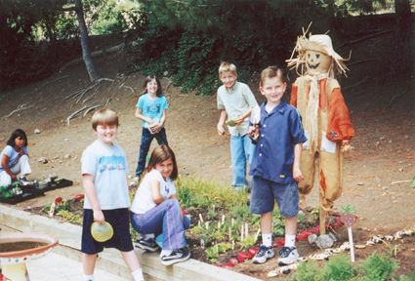
Thank you

