Slide 1
Maternal and child nutrition: effects on health and development throughout the life course
Christine P. Stewart, MPH, PhD
September 2012

Slide 2
Outline
Nutrition and epidemiologic transition
Nutrition in pregnancy
‘Barker hypothesis’ and the fetal origins of disease
Life course approach to nutritional epidemiology
Selected example: Obesity and diabetes during pregnancy

Slide 3
Background
Deficiencies during pregnancy or early childhood have been associated with an increased risk of mortality, morbidity, poor growth, and poor cognitive performance.
Overweight, obesity and associated co-morbidities are growing in prominence in many parts of the world
The consequences of obesity in pregnancy have only recently begun to be studied

Slide 4
The Nutrition Transition
Urbanization, economic growth, technological changes for work, leisure, and food processing
Pattern-3: Receding famine
Pattern-4: Degenerative disease
Pattern-5: Behavior change
Starchy, low variety, low fat, high fiber foods
Labor-intensive work/leisure
Increased fat, sugar, processed foods
Shift in technology of work and leisure
Reduced fat, increased fruits/veg, fiber
Purposeful change in recreation & leisure activities
MCH deficiencies, stunting
Obesity emerges, bone density prob.
↓ body fatness, ↑ bone health
Slow mortality decline
Altered life expectancy, ↑ NR-NCD
Healthy aging, ↓ NR-NCD
Adapted from Caballero & Popkin, 2002
Notes:
The Nutrition Transition is a term that has been used to describe the changing patterns of diet and physical activity that have been occurring much of the world, and that tend to coincide with the demographic and epidemiologic transitions. We think of the nutrition transition as a shift from periods of famine, with diets based on starchy-low fat, high fiber foods, with labor intensive work and leisure activities to one characterized by diets high in fat, sugar, processed foods, and shifts in technology that allow for more sedentary work and leisure activities. The first pattern is characterized by high levels of nutritional deficiency, child stunting, etc, and high mortality. In the second pattern, we see obesity emerge as a problem with an increase in nutrition-related non-communicable disease. Popkin has proposed a final pattern, characterized by behavior change to promote healthy lifestyle and aging, but thus far there are few examples of countries that have made this shift.

Slide 5

Obesity Trends* Among U.S. Adults
BRFSS, 1985
(*BMI ≥30, or ~ 30 lbs. overweight for 5’ 4” person)
No Data <10% 10%–14%

Slide 6
Obesity Trends* Among U.S. Adults
BRFSS, 2010
(*BMI ≥30, or ~ 30 lbs. overweight for 5’ 4” person)
No Data <10% 10%–14% 15%–19% 20%-24% 25%-29% ≥30%
Notes:
When we see data like this, we need to ask questions about what we see.
First: are the observed differences real?
Is it possible that differential reporting in different states could contribute to the trends?
Is it possible that differences in measurement of BMI could contribute to this trend?
Second: Why have these differences occurred?
Are there environmental differences that could explain regional differences in obesity prevalence?
Are there differences between the people that live in those areas?
Why have some regions experienced a greater rate of increase than others?

Slide 7
While the United States is an extreme example, populations globally are undergoing dramatic transitions in health and nutrition patterns
Individuals within those populations are undergoing dramatic transitions in diet, environmental exposures, and disease risk within their own lifetimes

Slide 8
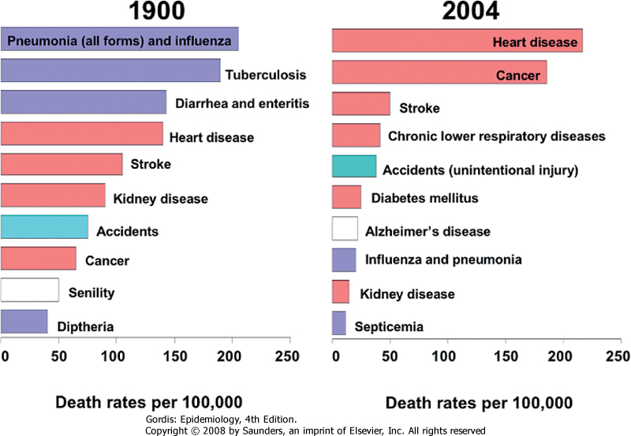
“Epidemiologic Transition”: Changes in leading causes of death over the past century
Figure 1-2 Ten leading causes of death in the United States, 1900 and 2004. Although the definitions of the diseases in this figure are not exactly comparable in 1900 and 2004, the bars in the graphs are color coded to show chronic diseases (salmon), infectious diseases (purple), injuries (aqua), and diseases of aging (white). (Redrawn from Grove RD, Hetzel AM: Vital Statistics Rates of the United States, 1940-1960. Washington, DC, US Government Printing Office, 1968; and National Center for Health Statistics: National Vital Statistics Report, vol 54, no 19, June 28, 2006.)

Slide 9
Nutrition in pregnancy

Slide 10
Nutrient metabolism
Fetus receives nutrient supply from across the placenta via either active transport or facilitated diffusion
Changes in nutrient metabolism in pregnancy are driven by:
  Hormonal changes
  Fetal demands
  Maternal nutrient supply

Slide 11
Nutrient metabolism
Types of adjustment
  Accretion of new tissues or deposition in maternal stores
  Redistribution among tissues
  Increased turnover or rate of metabolism
  Increased efficiency of nutrient absorption

Slide 12
Nutrient metabolism
Fasting and postprandial glucose levels increase to delivery glucose needed for fetal growth.
Elevated hormone levels increase insulin resistance, peaks in 3rd trimester.

Slide 13
Physiologic changes related to pregnancy
Gastrointestinal function
  Reduced intestinal motility, which leads to increased gastric emptying time (increased heartburn and constipation)
  Decreased smooth muscle tone resulting in increased water absorption
  Increased intestinal absorption of nutrients such as iron, calcium and vitamin B12
  Increased colonic absorption of water and sodium

Slide 14
Physiologic changes related to pregnancy
Renal function
  Renal plasma flow increases by 50-80%
  Glomerular filtration rate increases by 50%
  Increased urinary excretion of glucose, amino acids, and other nutrients
  Sodium and water retention increases

Slide 15
Physiologic changes related to pregnancy
Cardiovascular function
  Increased cardiac output (amount of blood pumped per beat per minute)
  Expansion of blood volume
    ~43% increase in plasma volume
    ~30% increase in number of blood cells (expansion of the red blood cell mass)

Slide 16
Changes in food intake during pregnancy
Some factors explaining changes in food intake:
  Morning sickness/ food aversions
  Cravings
  Taboos, food beliefs
  Changes in taste acuity (ex. salt)
  Nutritional counseling

Slide 17
Nutrient requirements of pregnancy
Nutrient requirements increase with pregnancy, but not proportionally
Maternal behavioral changes augment physiologic changes to meet nutrient requirements
A limit exists to the physiologic capacity to adjust metabolism. When that limit is exceeded, fetal growth & development are impaired

Slide 18
Long-term consequences of under- and Over-nutrition during pregnancy

Slide 19
Developmental origins of health and disease hypothesis
Early life nutritional and environmental factors may impact later life disease risk
Earlier research focused predominantly on fetal growth restriction (indicated by lower birth weight) and adult chronic disease risk

Slide 20
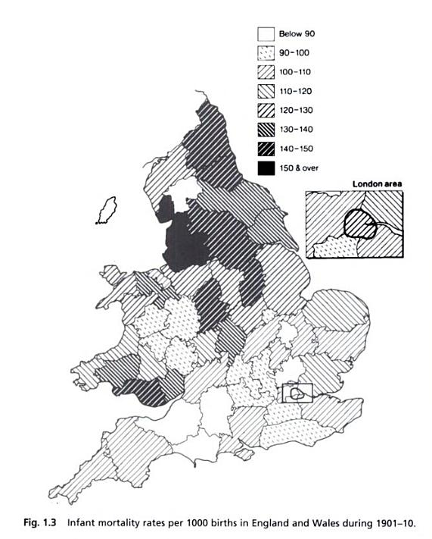
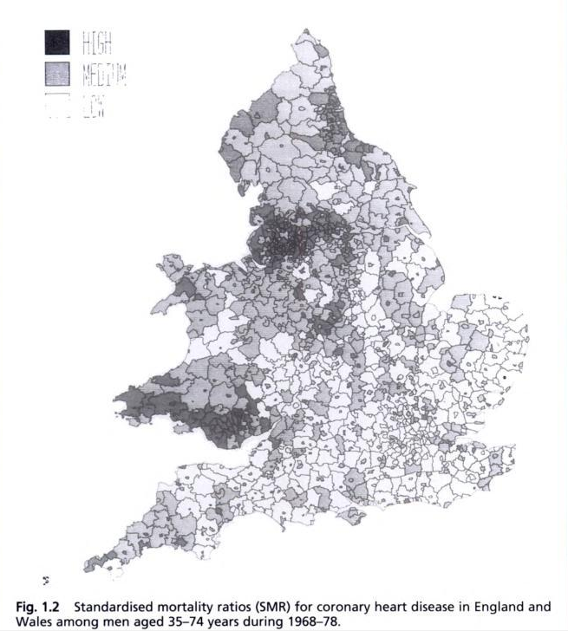
“Barker’s” Hypothesis
Infant mortality rates, 1901-1910
CHD mortality rates, 1968-1978
Barker, Mothers, babies and health in later life, 1998

Slide 21
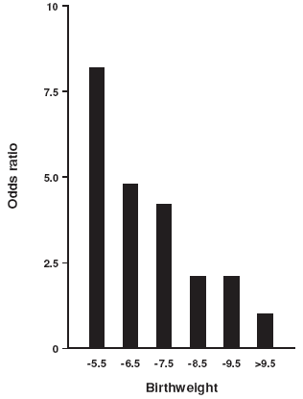
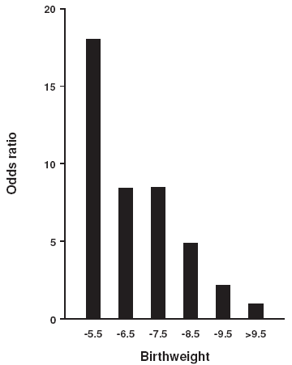
Odds ratios for impaired glucose tolerance or Type II diabetes among 64 yr old men in Hertfordshire (adjusted for adult BMI)
Odds ratios for metabolic syndrome among men in Hertfordshire (adjusted for adult BMI)
Hales & Barker, 2001

Slide 22
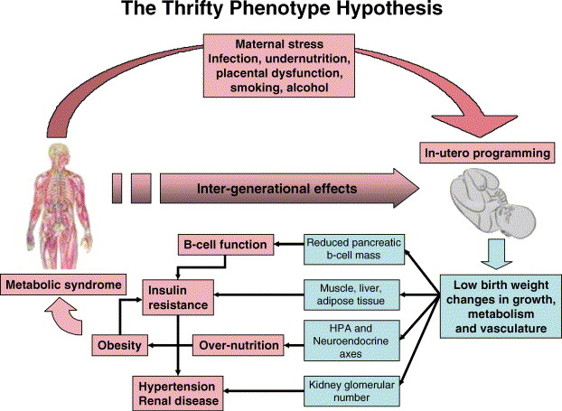
D.S. Fernandez-Twinn , S.E. Ozanne, Physiology & Behavior Volume 88, Issue 3 2006 234 - 243
Notes:
Barker’s hypothesis that exposure to poor nutritional conditions in utero and/or during the first months of postnatal life leads to alterations in the development of organs, tissues and/or body systems. These alterations may be advantageous in the short-term but may increase the predisposition to chronic diseases at older ages.

Slide 23

The Dutch Famine
Late 1944-May 1945
Food supplies in the northern and western regions of the Netherlands were halted due to a German blockade
A harsh winter froze the canals, effectively cutting off the vital supply routes
Food rations dropped to 500 calories per day
18,000 people died due to starvation during the famine
The Dutch “Hunger Winter” of 1944

Slide 24
Dutch Famine
Summary of findings in 50 year old survivors
  Exposed in early gestation
    Higher BMI & waist circumference (among women) (Ravelli 1999)
    Higher ratio of LDL to HDL cholesterol (Roseboom 2000)
    Increased risk of CVD (OR=3.0) (Roseboom 2000), though findings have been mixed (Lumey 2012)
    Lower selective attention span in late adulthood (de Rooij 2010)
  Those exposed during mid- or late gestation had:
    Born small and stayed small throughout their lives
    Reduced glucose tolerance (Ravelli 1998)
  Those exposed in mid-gestation had:
    Increased risk of microalbuminuria (OR=3.2) (Painter 2005)
    Increased risk of obstructive airways disease (OR=1.7) (Lopuhaa 2000)

Slide 25
Epigenetics
We certainly need to remember that between genotype and phenotype, and connecting them to each other, there lies a whole complex of developmental processes.
E.H. Waddington, 1942

Slide 26
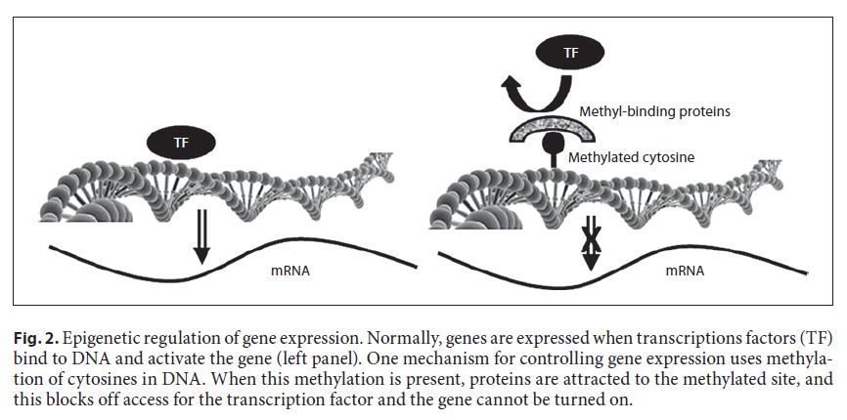
Epigenetics
  DNA methylation
  Histone modification
  Non-coding RNAs
Zeisel, 2012
Notes:
DNA methylation will effectively ‘turn off’ certain genes. Ex: Diets high in methyl donor nutrients can alter insulin-like growth factor signaling
Histones: proteins in cell nuclei that package and order DNA into structural units. Ex. Chromatin, which act as a spool around which DNS winds, and plays a role in DNA regulation.
Non-coding RNAs: play a role in translation of DNA

Slide 27
The ‘fetal origins of disease’
Animal evidence has been fairly strong and consistent:
  Global nutrient restriction, restriction in methyl-donor nutrients (folate, B6, B12, choline), some minerals (Zn, Mg) has adverse effects on cardiovascular development, renal development, insulin signaling, body composition
  Effects are exacerbated when exposed to a ‘high fat’ or ‘western’ diet postnatally

Slide 28
The ‘fetal origins of disease’
Human evidence has been mixed
  Long duration of time needed for follow-up contributes to selection bias
    Large losses to follow-up
    Survivor bias
  Confounding by socioeconomic factors, other environmental exposures
  Difficulty to disentangle prenatal from postnatal effects
  Difficulty in determining metabolic pathways when ‘insult’ may have occurred decades prior

Slide 29
Evolutions in epidemiologic thinking
The field of epidemiology developed predominantly as a study of infectious disease epidemics
Over time, there has been a transition from infectious disease to chronic disease as the primary cause of morbidity and mortality in many countries. Resulting need for new ways of thinking to understand disease causality.
More recently, investigators have taken a ‘life course’ approach to study a variety of health and disease outcomes related to both under- and over-nutrition (among other exposures) during fetal development and beyond.

Slide 30
Differences in ways of thinking about disease causality
How long would you have to wait to see an outcome?
Exposure to flu virus
Incident flu symptoms
vs.
Poor diet
Diabetes

Slide 31
What causes disease?
Adult risk factors
Does each factor independently cause CVD?
Smoking
Cardiovascular disease
Excessive alcohol
Low physical activity
Poor diet

Slide 32
What causes disease?
Adult risk factors
Do you need a combination of risk factors to cause CVD?
Smoking
Cardiovascular disease
+
Excessive alcohol
+
Low physical activity
+
Poor diet

Slide 33
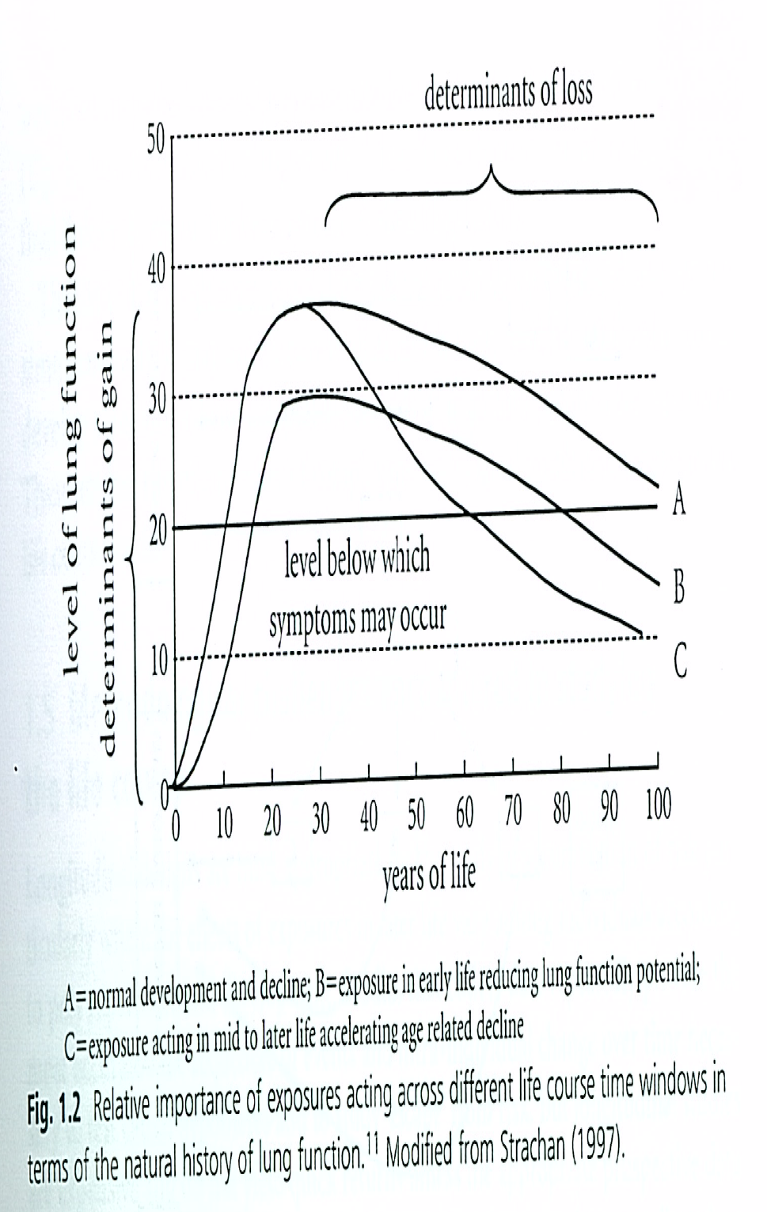
What causes disease?
Factors in childhood
Are there critical periods of life in which you are most sensitive to risk?
Lung function
Kuh & Ben-Shlomo, 2007

Slide 34
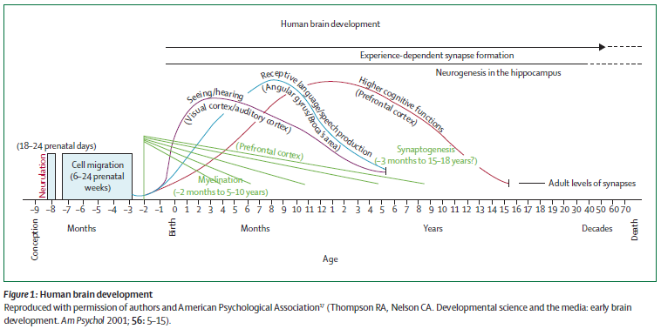
What causes disease?
Factors in fetal development and infancy
Are there critical periods of life in which you are most sensitive to risk?
Brain development
Grantham-McGregor, 2007
Notes:
The brain develops
rapidly through neurogenesis, axonal and dendritic growth,
synaptogenesis, cell death, synaptic pruning, myelination,
and gliogenesis. These ontogenetic events happen at
diff erent times (fi gure 1)17 and build on each other, such
that small perturbations in these processes can have
long-term eff ects on the brain’s structural and functional
capacity.

Slide 35
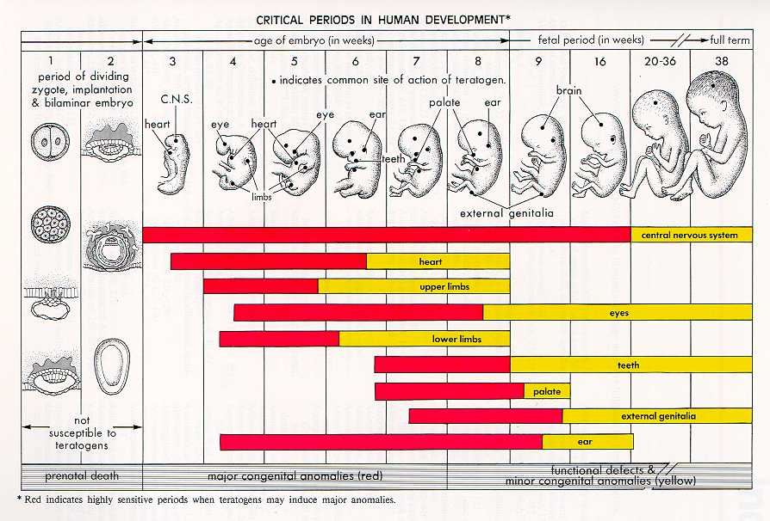
Critical periods of human development
Adapted from Moore, The Developing Human, 3rd ed 1982
Notes:
Hyperplasia– increase in cell number
Hyertrophy– increase in cell size

Slide 36
Consequences of overweight/obesity and complications due to diabetes during pregnancy

Slide 37
Weight gain recommendations
Pre-pregnancy BMI | BMI (kg/m²) | Total weight gain range | Rates of weight gain in 2nd & 3rd trimester (mean range in lbs/wk)
Underweight | <18.5 | 28-40 | 1 (1-1.3)
Normal weight | 18.5-24.9 | 25-35 | 1 (0.8-1)
Overweight | 25.0-29.9 | 15-25 | 0.6 (0.5-0.7)
Obese (includes all classes) | ≥30.0 | 11-20 | 0.5 (0.4-0.6)
IOM, 2009

Slide 38
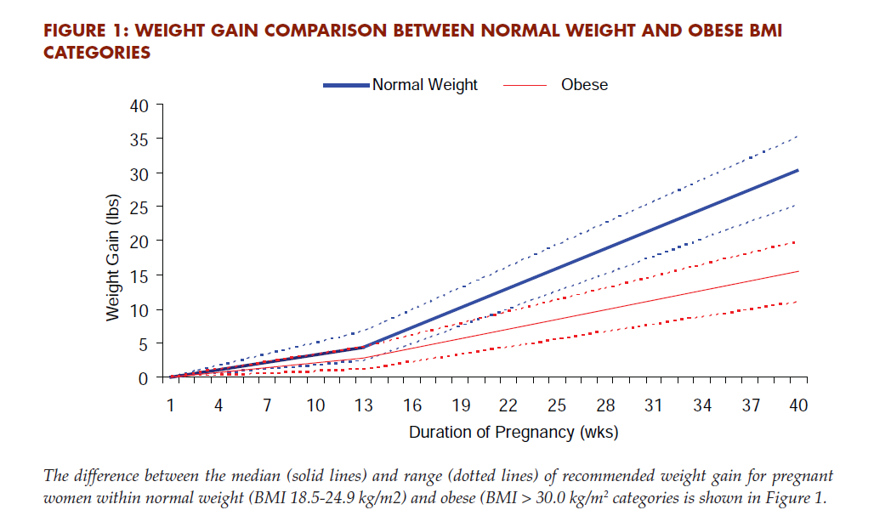
Recommended weight gain for normal weight and obese mothers
IOM, 2009

Slide 39
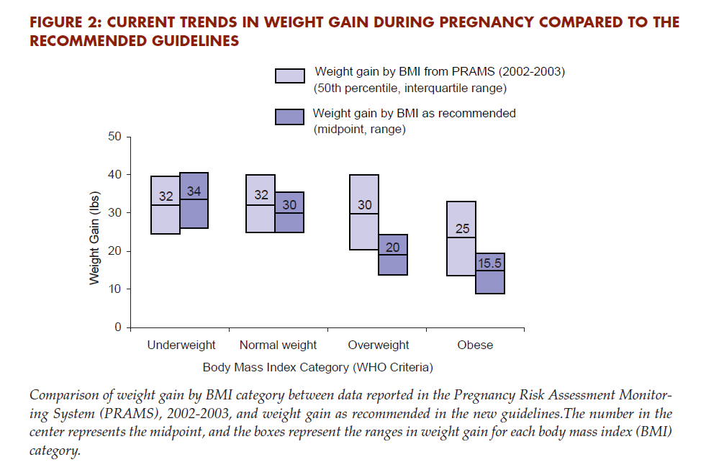
Recommendations vs. reality
IOM, 2009

Slide 40
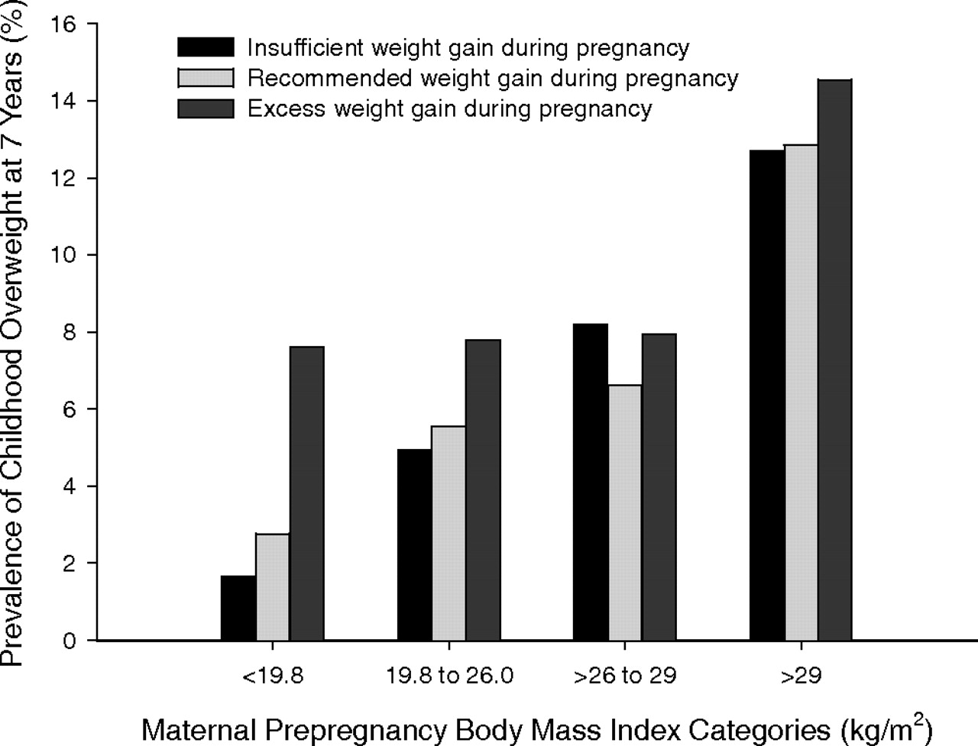
Prevalence of childhood overweight at 7 y by maternal pre-pregnancy BMI categories and gestational weight gain categories.
Wrotniak B H et al. Am J Clin Nutr 2008;87:1818-1824
©2008 by American Society for Nutrition
Notes:
Prevalence of childhood overweight at 7 y by maternal prepregnancy BMI categories and gestational weight gain categories. In chi-square analyses, the prevalence of offspring overweight differed (P < 0.02) between gestational weight gain categories for women with a prepregnancy BMI < 19.8 and with a prepregnancy BMI of 19.8 to 26.0. The risk of overweight in the offspring was lowest for mothers with a BMI < 19.8 who gained an insufficient amount of weight during pregnancy (prevalence of childhood overweight = 1.7%) and greatest for mothers with a BMI > 29 who had gained an excessive amount of weight during pregnancy (prevalence of childhood overweight = 14.5%). Excessive, recommended, and insufficient gestational weight gain are defined based on criteria from the Institute of Medicine (12).

Slide 41
Diabetes during pregnancy
Infants of diabetic mothers are at significantly greater risk of spontaneous abortion, stillbirth, congenital malformations, morbidity and mortality
3-10% of pregnancies in the United States are affected by abnormal glycemic control, 80% of these are gestational diabetes (GDM)
GDM is strongly associated with obesity (Chu, 2007):
  Overweight women: 2.1 fold greater risk
  Obese women: 3.6 fold greater risk
  Morbidly obese women: 8.6 fold greater risk

Slide 42
Diabetes during pregnancy
Fetus is exposed to hyperglycemia, resulting in increased fetal insulin levels that serves as a growth promoter and storage of excess energy as fat
Fetal macrosomia may result

Slide 43
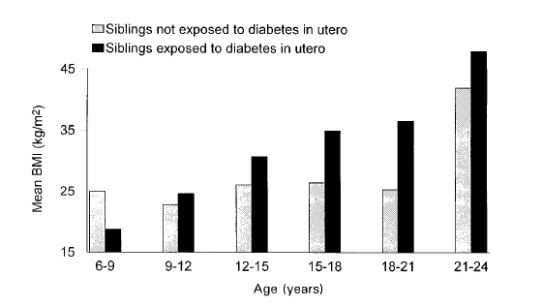
Mean BMI in siblings exposed and unexposed to a diabetic intrauterine environment
Dabelea et al, 2000

Slide 44
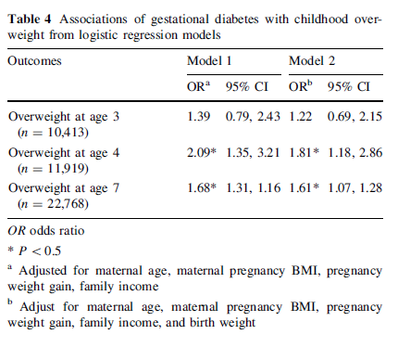
Fraser et al, 2012

Slide 45
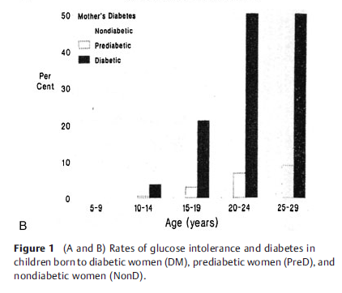
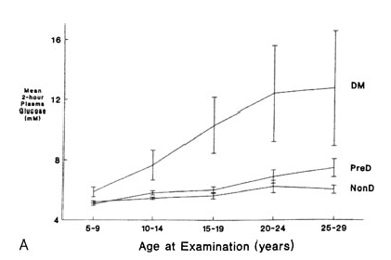
Risk of diabetes in offspring of diabetic mothers (Pima Indians)
Glucose intolerance
Prevalence of Diabetes
Notes:
Although diabetes was not diagnosed until older ages, evidence of glucose intolerance was evident early in childhood.

Slide 46
Fetal hyperinsulinemia
Fetal hyperinsulinemia in response to maternal hyperglycemia is a strong predictor of impaired glucose tolerance in later life
In animal models, fetal hyperinsulinemia elevates expression of neuropeptide Y (NPY) in the hypothalamus that results in hyperphagia and weight gain in postnatal life

Slide 47
Diabetes during pregnancy: Iron metabolism
Uncontrolled glycemia during pregnancy can result in fetal hypoxemia
The fetus responds by increasing oxygen carrying capacity of the red blood cell mass.
With RBC mass expansion of up to 30%, fetal iron demands are greatly increased
Placenta up-regulates iron transport, but cannot fully compensate for higher requirements
The fetus draws down fetal liver iron stores
  55% reduction in heart iron
  40% reduction in brain iron

Slide 48
Diabetes during pregnancy: cognitive impairments
Reduced performance on tests of general development in infancy and toddlerhood (deRegnier et al 2000)
Modest reduction in performance on learning and memory tasks in 3.5 y old children (Riggins et al 2009)
Reduced school performance, educational attainment, and IQ (Fraser et al 2012)
Impairments are generally mild to moderate, so may be possible to compensate with targeted interventions

Slide 49
Conclusions
Nutrition during fetal development can have a life-long impact on health and disease risk
Understanding the consequences of nutritional deficiencies or excesses in pregnancy requires a life-course approach, an understanding of the physiology of pregnancy, and of biologic ‘critical windows’ of development

