Slide 1
Nutrition and Physical Activity in Native Hawaiians and Pacific Islanders
A community and evidence-based perspective
Archana J. McEligot
  CSUF
Juliet McMullin
  UCR
Ka’ala Pang
Kawai Pang
  PIHP-Hawaii
Charlene Kazner
  Ainahau O Kaleponi Hawaiian Civic Club

Slide 2
Objectives
1. Identify the community’s nutrition and PA challenges
2. Understand the health disparities for Pacific Islanders
related to nutrition
3. Familiarize the audience to Pacific Islander dietary
intakes and needs
4. Discuss the social determinants/cultural context for diet
and PA in Pacific Islanders
5. Characterize dietary interventions in Pacific Islander
populations

Slide 3

Our Values
Pili
Aloha
Mālama kekahi I kekahi
Maihilahila
Na’auao
Ano ano hua

Slide 4
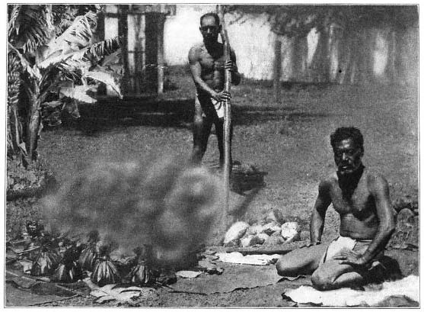
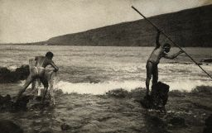
Healthy Pacific Islanders
Health problems aren’t necessarily “who” NHPI are, traditionally their diet, lifestyle and health conditions were excellent

Slide 5
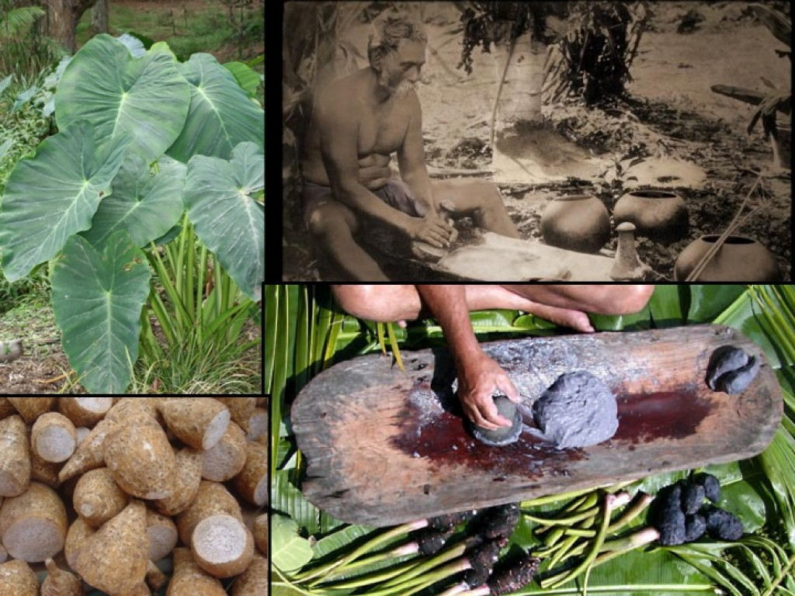
Healthy Pacific Islanders
Source: Brittany Todd

Slide 6
Healthy Pacific Islanders
Discussion of weight, diet and exercise
  Weight as very unhealthy vs question of size
  Being able to do what you want to do.
    “I see some very big Hawaiians, but they’re still doing the things they want to do”
“It’s the way you carry yourself”
    the emotion of being Hawaiian

Slide 7
Hula Warm-up

Slide 8
Pressing Problems
Objective 2: Health Disparities related to nutrition and PA in NHPI

Slide 9

“Some of the problems are well known and we know what we should do…”
Diseases
  Diabetes, heart disease, cancer
Practices
  Diet and exercise
    Nutritious vs non-nutritious
      Fast vs home cooked
      Hawaiian vs American

Slide 10
What Are Our Health Disparities? - Population
According to the 2000 U.S. Census, there are 874,000 reported Native Hawaiian and Other Pacific Islanders, which account for 0.3% of the entire U.S. population ¹.
Native Hawaiians and Pacific Islanders, as a group, experienced 2.4% growth between 2007 and 2008, third overall among race groups; Asians and Hispanics were second and first respectively².
Native Hawaiians are the largest Pacific Islander group in the U.S. followed by Samoan, and Guamanian or Chamoru. These three groups account for 74% of the total respondents who reported belonging to a single Pacific Islander group¹.
1: Grieco, E. M. (n.d.). The Native Hawaiian and Other Pacific Islander Population: 2000 (p. 1, Issue brief No. C2KBR/01-14). doi:
http://www.census.gov/prod/2001pubs/c2kbr01-14.pdf
2: Paisano, Edna L. We the American: Pacific Islanders. Rep. Washington, DC: U.S. Government Printing Office, 1993. W. U.S. Department of Commerce Bureau of the Census, Sept. 1993. (p.3) <http://www.census.gov/apsd/wepeople/we-4.pdf>.
From: White House Initiative on Asian Americans and Pacific Islanders Fact Sheet

Slide 11
What Are Our Health Disparities?
Native Hawaiians are over 5 times as likely to experience diabetes between the ages of 19‐35 (11% vs. 2%) compared to non‐Hawaiians (Mau, Epi Reviews, 2009; Papa Ola Lokahi, NH Epi Center Pub).
Native Hawaiians have the highest rate of deaths due to cancer compared to any other ethnic group in Hawaii (229 per 100,000) and the 2nd highest rate in the country. (Chu KC, Cancer 2005).

Slide 12
What Are Our Health Disparities?
Pacific Islanders reported higher adjusted rates of hypertension (1.50; 1.06, 2.13), diabetes (1.82; 1.25, 2.63), asthma (2.32; 1.65, 3.25), and arthritis (1.68; 1.20, 2.35). Pacific Islanders also more frequently reported having fair or poor health (1.46; 1.05, 2.04).
  Most differences in self-reported health status and chronic disease outcomes were mediated by higher rates of overweight and obesity, but not higher rates of smoking, among Pacific Islanders (Bitton, J Gen Intern Med. 2010).
According to the CDC, Native Hawaiians and other Pacific Islanders have the second highest rate of diagnoses of HIV infection and the second shortest AIDS survival rate of all Americans (Stafford, AJPH, 2010).

Slide 13
Health in Children
Source: Ethnic Health Assessment for Asian Americans, Native Hawaiians, and Pacific Islanders in California, August 2010
Among children, California schools use Healthy Fitness Zones (HFZ) to evaluate whether a student meets the HFZ goal of physical activity and body composition.
NHPIs reported the highest proportion of 5th graders whose Body Mass Index (BMI) are not in the HFZ, with Samoans (53.9%) and Other Pacific Islanders (41.5%) having the highest rates across all racial/ethnic groups.
Guamanian (34.7%), Native Hawaiian (34.6%), and Tahitian (34.4%) Californians also reported higher rates of 5th graders whose BMI are not in the HFZ compared to the state average (32%).
More Samoan, Guamanian, Native Hawaiian, and Tahitian children have a body mass index (BMI) not within the Healthy Fitness Zone compared to the state average.

Slide 14
Demographics of DABS
%
McEligot, McMullin, Pang, HMJ, 2010

Slide 15
What Are Our Health Disparities?
McEligot, McMullin, Pang, HMJ, 2010

Slide 16
McEligot, McMullin, Pang, HMJ, 2010

Slide 17
Body Mass Index
McEligot, McMullin, Pang, HMJ, 2010

Slide 18
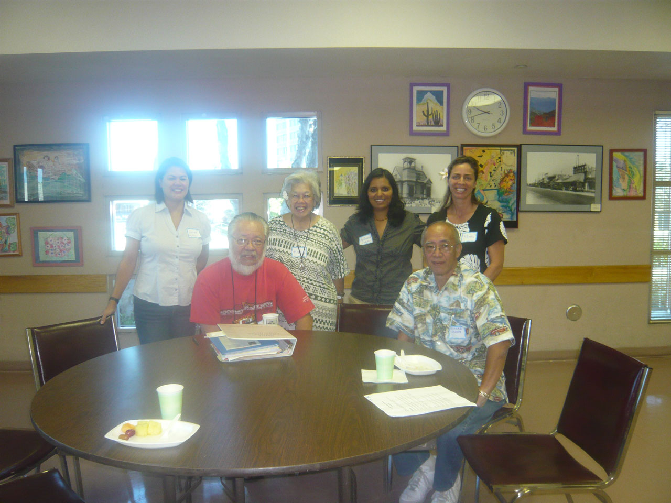
`A`ohe hana nui ke alu `ia
(No work is too large when done by all)
Objective 3. Familiarize the audience to Pacific Islander dietary intakes and needs
Objective 4: Discuss the social determinants/cultural context for diet and PA for NHPI

Slide 19
What Are We Eating? Major studies on Diet and Nutrition for NHPI
Wai’anae Diet Program, incorporated traditional Hawaiian values with a Traditional Hawaiian Diet (THD) of kalo (taro), poi (mashed taro), ‘uala (sweet potato), fish and chicken (1 - 3).
The PILI ‘Ohana project, a CBPR partnership, conducted in Hawai`i encourages culturally-sensitive healthful lifestyle behavior change through various nutrition and physical activity strategies (4), and results have shown reduction in weight and dietary fat intakes.
The Multi-ethnic cohort study, cross-sectional study between Hawaii and California assessing dietary intakes among five ethnic groups
1. Fujita R, Braun KL, Hughes CK. The traditional Hawaiian diet: a review of the literature. Pac Health Dialog. 2004;11:250-9.
2. Shintani T, Beckham S, O'Connor HK, Hughes C, Sato A. The Waianae Diet Program: a culturally sensitive, community-based obesity and clinical intervention program for the Native Hawaiian population. Hawaii Med J. 1994;53:136-41.
3. Shintani T, Beckham S, O'Connor HK, Hughes C, Sato A. The Waianae Diet Program: a culturally sensitive, community-based obesity and clinical intervention program for the Native Hawaiian population. Hawaii Med J. 1994; 53:136-41.
4. Nacapoy AH, Kaholokula JK, West MR, Dillard AY, Leake A, Kekauoha BP, Palakiko DM, Siu A, Mosier SW, Marjorie KM; PILI 'Ohana Project. Partnerships to address obesity disparities in Hawai'i: the PILI 'Ohana Project. Hawaii Med J. 2008 Sep;67(9):237-41.

Slide 20
What Are We Eating?
 | Mean | Recommended Daily Allowance
Whole Grain (serv) | 1.63 | 4.5
Refined Grain (serv) | 3.73 | 4.5
Vegetables (serv) | 2.52 | 5
Fruits (serv) | 1.66 | 5
Fiber (g) | 16.84 | 25 - 30
Monounsaturated Fat (%) | 13.11
Polyunsaturated Fat (%) | 7.21
Saturated Fat (%) | 11.07 | < 10%
Total Fat (%) | 34.39 | < 30%
McEligot, McMullin, Pang, HMJ, 2010

Slide 21
 | Males (N=21) |  |  | Females (N=34)
 | Mean (SD) | Range | % above guidelines^{a,b} | Mean(SD) | Range | % above guidelines^{a,b}
Food Intake
Energy kcal | 1882 (710) | 992-3220 |  | 1601 (615) | 579-3010
% Energy from fat | 33.7 (5.9) | 22.3-44.2 | 24 | 34.8 (8.4) | 18.2-48.3 | 22
Fiber, g | 19.5 (6.3) | 7.9-30.1 | 19 | 15.2 (7.3) | 2.8-31.4 | 12
Vegetable, servings | 2.9 (1.7) | 0.7-6.6 | 14 | 2.3 (1.4) | 0-5.8 | 3
Fruit, servings | 1.9 (2.1) | 0-8.3 | 14 | 1.5 (1.2) | 0-5.6 | 3
Whole grain, servings | 2.0 (2.0) | 0-8.6 | 5 | 1.4 (1.3) | 0-5.4 | 0
Refined grain, servings | 4.0 (1.5) | 0-7.3 | 66 | 3.5 (2.1) | 0-9.0. | 56
Total Folate, μg | 452 (204) | 240-995 | 52 | 393 (285) | 104-1781 | 35
Natural Folate, μg | 265 (125) | 123-609 | 19 | 204 (89) | 123-607 | 3
Synthetic Folate, μg | 187 (166) | 46-853 | 5 | 190 (236) | 23-1373 | 9
Vitamin C, mg | 110 (92) | 28-322 | 48 | 83 (53) | 23-205 | 44
Vitamin E, IU | 10.3 (6.2) | 3.4-28.0 | 19 | 13.4 (17.4) | 1.8-100.9 | 18
Total carotenoids, μg^{c} | 10913 (6676) | 1672-25118 |  | 8857 (6568) | 487-25161
Calcium, mg | 754 (459) | 234-2433 | 10 | 714 (332) | 129-1568 | 9
Iron, mg | 15.5 (5.5) | 8.9-32.2 | 100 | 13.6 (9.6) | 4.4-61.2 | 79
Supplement Intake
Folate, μg | 175 (246) | 0-900 | 33 | 251 (309) | 0-1000 | 44
Vitamin C, mg | 168 (404) | 0-1500 | 38 | 163 (330) | 0-1060 | 26
Vitamin E, IU | 94 (214) | 0-833 | 43 | 65 (151) | 0-667 | 47
Carotenoids, μg^{c} | 217 (598) | 0-2550 |  | 1247 (6500) | 0-38002
Calcium, mg | 139 (272) | 0-1120 | 0 | 367 (661) | 0-2970 | 9
Iron, mg | 2.4 (8.2) | 0-36.3 | 10 | 3.8 (8.3) | 0-36 | 18

Slide 22
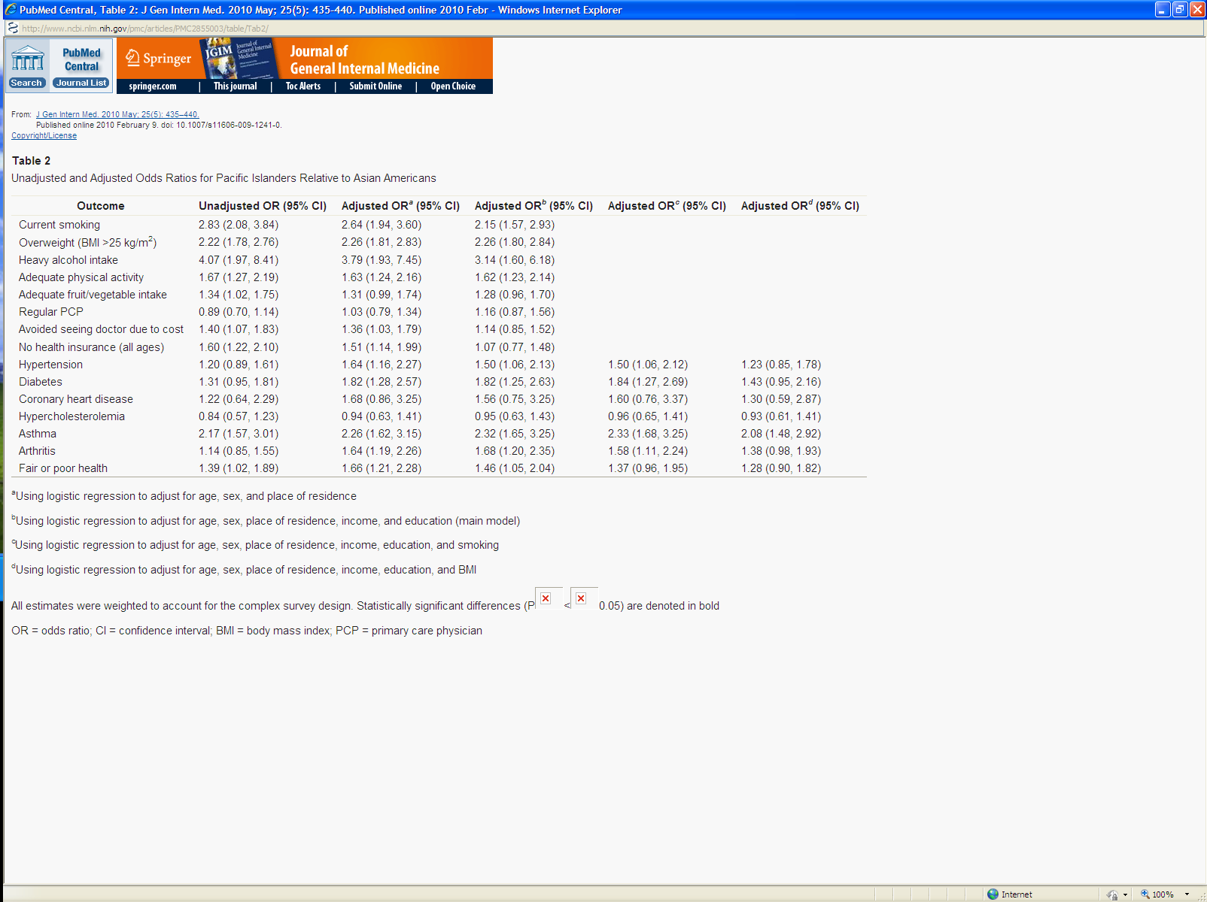
Bitton A. J Gen Intern Med , 2010

Slide 23

Bitton A. J Gen Intern Med , 2010

Slide 24
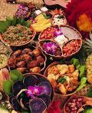
“Hawaiians don’t eat until they’re full, they eat until they’re tired” -
Joking and portion size
  It’s disrespectful not to eat what’s on your plate
  We bring lots of food to social events
  “that’s how you know who is Hawaiian”
  We expect to see lots of food at social events
    Similar across Pacific Islander groups
Generational issues
  Depression era
  Poverty
“It’s difficult to preach to family members…”
  Individual choice
  People are stubborn

Slide 25
D.A.B.S. Diet Attitudes and Beliefs Study
Top 5 Choices
Poi
Fish
Lomi lomi salmon
Laulau
Sweet Potato
Others : rice, taro leaf, ulu

Slide 26
Objective 4: Social Determinants
Migration issues
  Fund raisers for groups back home
  Access to food and changes in food
    Research by Craig Janes – Samoan Communities
      Migration, Social Change, and Health: A Samoan Community in Urban California. Stanford University Press 1990
  Various political relationships
    Watch Talk Story with George and Greta Briand (Marshall Islands)

Slide 27
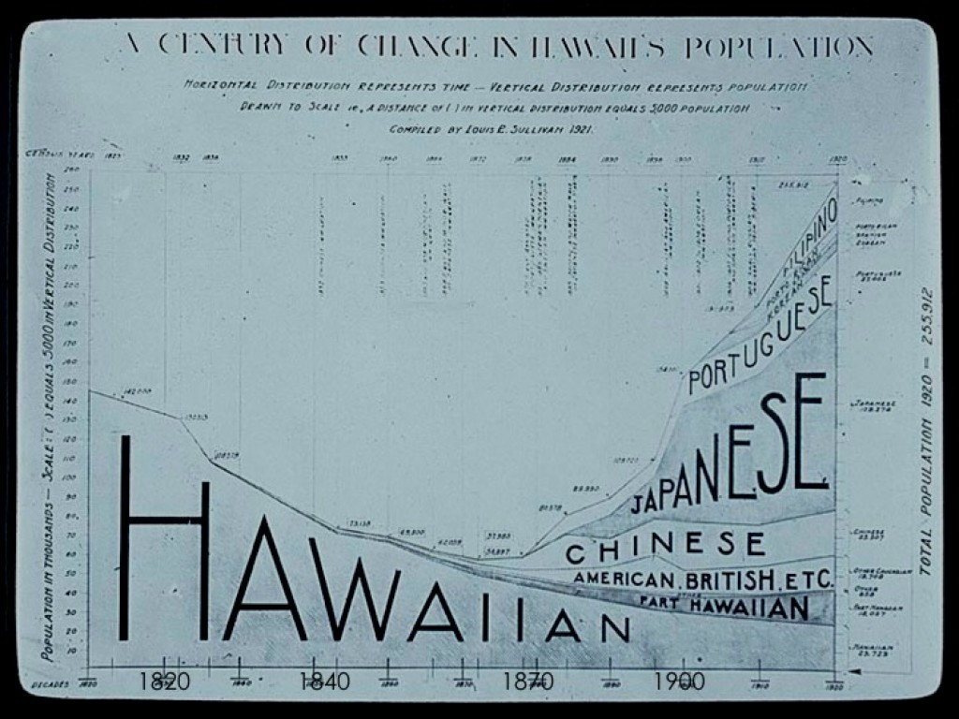
Objective 4: Social Determinants

Slide 28
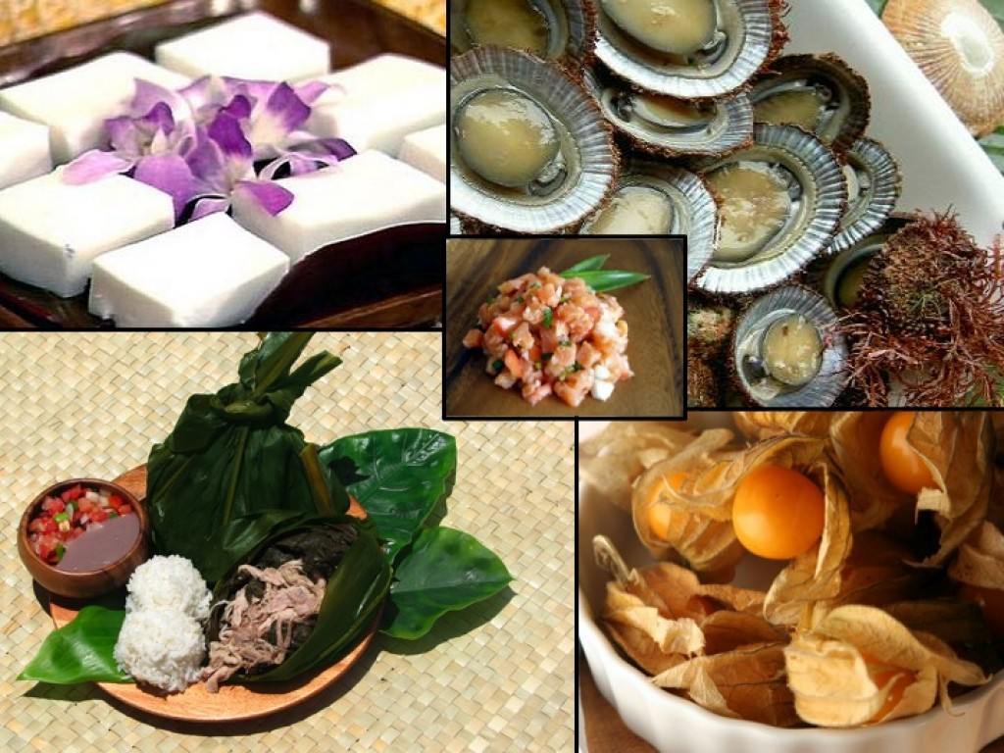
Acculturation, Migration and Diet
Source: Brittany Todd: http://brittanytodd.hubpages.com/hub/Hawaiian-Food-Culture-The-Evolution-and-Effects-of-Local-Food#

Slide 29
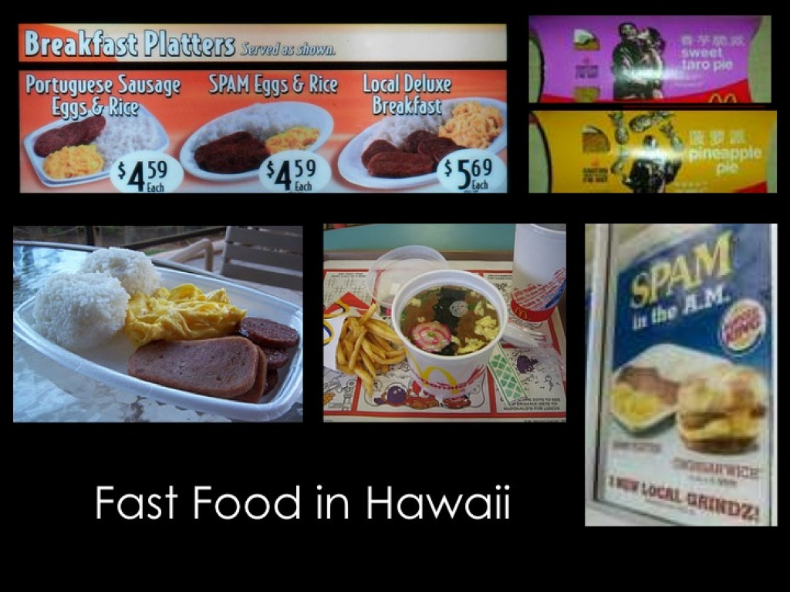
Acculturation, Migration and Diet
Source: Brittany Todd: http://brittanytodd.hubpages.com/hub/Hawaiian-Food-Culture-The-Evolution-and-Effects-of-Local-Food#

Slide 30
Reasons for Leaving Country of Birth
OPPORTUNITY
Better Job
American Dream
Change of Life
Experience Living Away from Home
College

Slide 31


Stress, work and distance
“It’s just more stressful to live in California”
  Longer work hours
  Activities after work
    Staying home to do homework, playing video games
    Commuting – “I just feel so lucky to be home”
  Local environment
    Beaches and parks are often very far away from where you live and work
    Safety of the environment

Slide 32
Stress, work and distance
http://www.youtube.com/watch?v=-awmSB2L7UE
Dateline – “The Wai’anae Diet”
Interview on Hawaiian Obesity

Slide 33
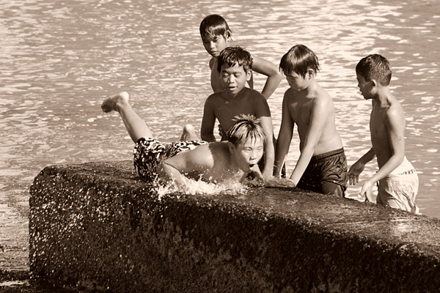
“To help get our ‘ōkole going…”
Social vs individual
  “if the kids go, then I have to go. And if the kids are there, then the grandparents will go”
  “Activities should be social events, but should have a component that shows us how to do these things at home.”
Photo from www.ferenc.biz/archives/storiesofphotographers

Slide 34
Access
  Environment and healthy spaces
  where you can get Hawaiian foods
    “I lived here 10 years before I finally was able to hook up with the community. Now I am learning where I can get Hawaiian foods.”
How to share foods
  Too much food for the kupuna or singles
  Community Gardens
    Famili Pe Taha – Steven Fifita

Slide 35
Objective 5: Characterize dietary interventions in NHPI populations – Traditional Hawaiian Diet (THD)
Traditional Foods:
kalo (taro)
weet potato
poi (mashed taro)
fish
chicken
(both fish and chicken were occasionally eaten).
Preparation and cooking methods. Traditional Hawaiian diets were extremely low in fat primarily due to the simplicity of the cooking methods, as well as consumption of a high fiber, complex-carbohydrate diet.
Cooking methods emphasized for the present study include:
Baking
Steaming
Broiling
Boiling

Slide 36
Objective 5: Characterize dietary interventions in NHPI populations – PILI ‘Ohana
The PILI ‘Ohana program includes eight sessions focusing on lifestyle change, including:
Overview of the PILI Lifestyle Intervention
Getting started on eating less fat
Being more active
Healthy eating and monitoring
Keeping to reduced calories
Taking charge of your diet/environment
Communicating with health care providers
A wrap up session
Mau MK, Keawe'aimoku Kaholokula J, West MR, Leake A, Efird JT, Rose C, Palakiko DM, Yoshimura S, Kekauoha PB, Gomes H.
Prog Community Health Partnersh. 2010 Spring;4(1):7-16.

Slide 37
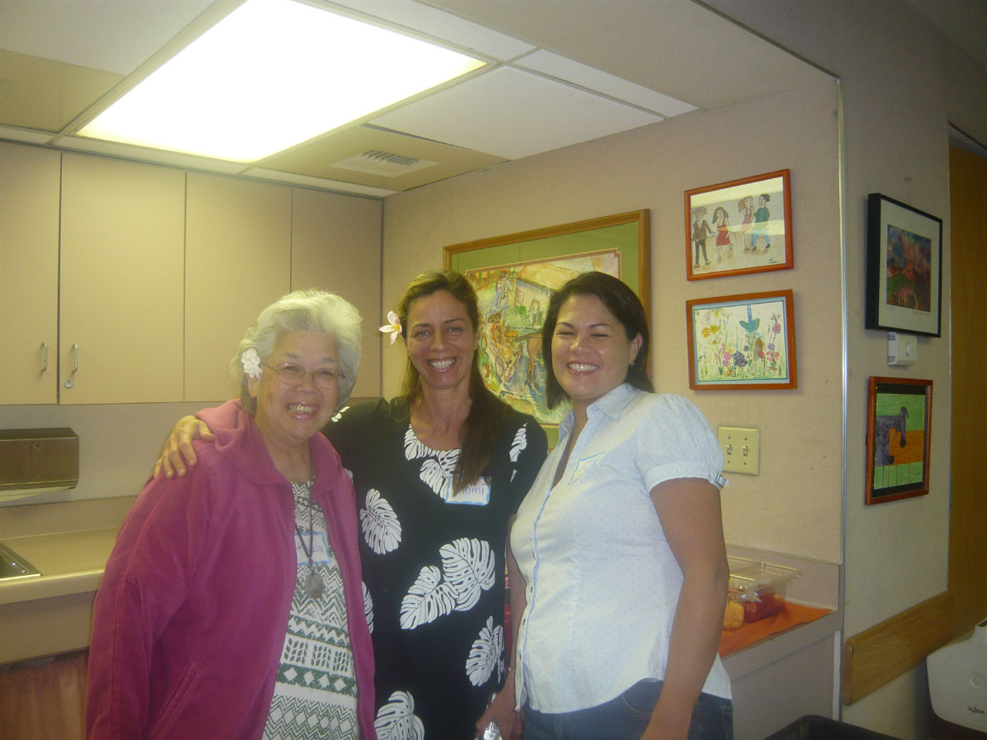

`A`ohe hana nui ke alu `ia
Native Hawaiian Community
Ka’ala and Victor Pang & PIHP-Hawaii
Momi Bone & Charlene Kazner
Ainahau O Kaleponi
Hawaiian Civic Club
CSUF – Archana J. McEligot
CSUF - Michele Wood
WINCART – Sora Tanjasiri
UCR – Juliet McMullin
CSUF students
  Shauna Winston
  Rebekah Ngewa
  Ryan Alano
  Tiffany Price

