Slide 1


Pacific Islander Health Partnership (PIHP)
Childhood Obesity & Nutrition Native Hawaiian Pacific Islander
Nov. 5, 2012
Jane Ka`ala Pang, RN, PHN, Retired
Victor Kaiwi Pang, President/Chair
1505 E. Seventeenth Street, Suite 220
Santa Ana, CA 92705

Slide 2
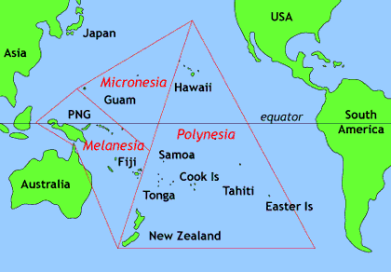
Indigenous Peoples from the Pacific

Slide 3
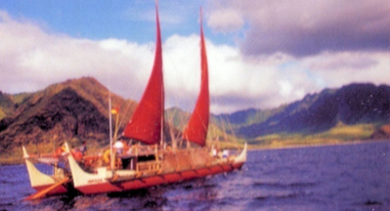
ALOHA
Talofa (Samoan)
Malo e lelei (Tongan)
Kiorana (Tahitian)
Ki ora (Maori)
Hafa adai (Chamorro)
Iakwe (Marshallese)
Alii (Palauan)
Bula (Fijian
Polynesian-Micronesian-Melanesian
GREETINGS from the Pacific

Slide 4
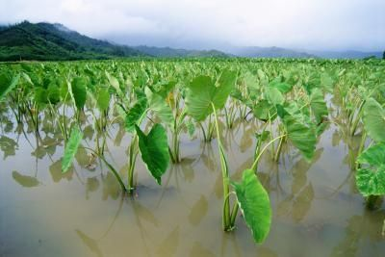
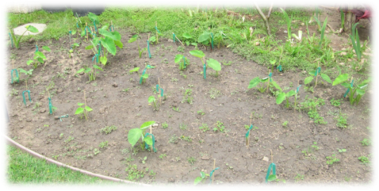
Beginning of time: Mana, Life force
WAKEA - "Sky," the wife Papa “earth;
Father Sky and Mother Earth are the first parents of human life on earth; first born still birth; buried – grew KALO, elder brother of Hawaiians

Slide 5
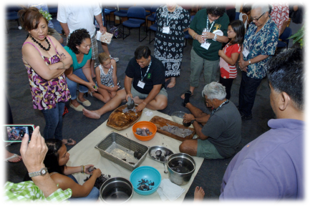
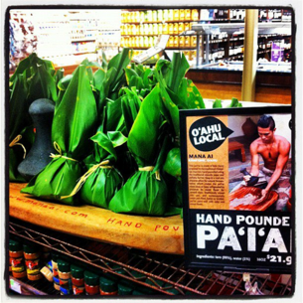
TARO – Soul Food of Hawai`i
Rich in fiber, calcium, potassium, iron
Vit. A, B1, B2, C
Poi: kinolau of Kāne, giver of water

Slide 6


Hawaiian Cultural Values
Māna: mother feeding infants ‘mouth – mouth’
‘Mai, mai, komo mai!
  Come, come, come in!
Mai e `ai!
  Come and eat!
Food is Life
Food - tradition
Ho`okipa – hospitality
Kuleana – learn roles with food preparation; role
Learn through observation

Slide 7
Hawaiian Food Preparation
Laulau: steamed ti-leaf wrapped fish, pork, beef
Lāwalu: ti-leaf wrapped, to cook over coals
Limu: seaweed, algae
Lū`au: taro leaves, feast
Poi: Hawaiian Staff of Life
Pulehu: to boil
Ulu: breadfruit
`Uala: sweet potato
`Alaea: condiment
Hāloa: first Hawaiian male, ancestor of chiefs
Haupia: coconut pudding
He`e: octopus
Hō`i`o: endemic fern
`Inamona: roasted kukui nut, relish salt
Kokua: help, assist

Slide 8
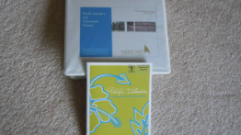
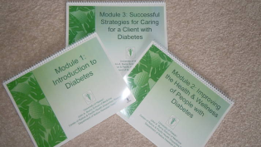
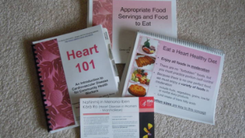
NHPI Health Disparities:
Cancer, Diabetes, Heart Disease, Obesity
Cancer: late, poor screening, late stage Dx with poorer outcome
Diabetes: 1:5 w/ diabetics
Heart Disease:
Obesity:

Slide 9

Recognize that because childhood obesity is a complex, multi-level problem, efforts to address the problem must take place at every level of the community. Like every epidemic, everyone in the community, from children and parents to teachers, business leaders and politicians must be engaged, educated and informed

Slide 10
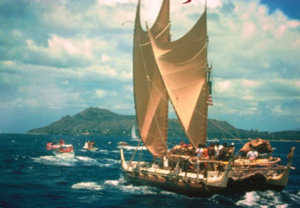

Mahalo nui loa, fa`afetai, malo `aupito, si yu`us ma`ase, sulang, kommol tata
Pacific Islander Health Partnership
1505 E. 17th Street, Suite 220
Santa Ana, CA 92705
Tel: (714) 968-1785
www.pacificislanderhealthpartnerhsip.net

