Slide 1


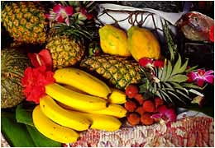

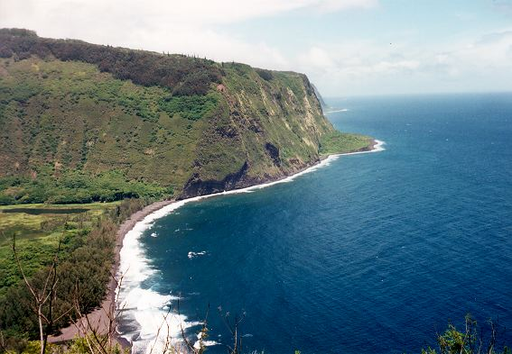
Native Hawaiian & Pacific Islanders
and Asian Americans
Are there differences?
Archana J. McEligot, PhD
CSU Fullerton
HESC 470

Slide 2
Objectives
Provide data on AA & NHPI diversity
Distinguish groups geographically and culturally
  a. Asian Americans
  NHPI
Present brief history of NHPI
Outline population changes in US
Discuss obesity trends between groups
Provide data on health disparities
7. Activity

Slide 3

Hafa
Bula (Ni sa bula vi naka)
Yokwe yuk
Aloha
Alii
Malo
som pas
Selamat pagi
Selamat sore
Selamat siang
Selamat malam
Selamat tidur
sa-bai-dee
chao
Ia ora na 'outou
Malo e lelei
Hello

Slide 4
Diversity in AA and NHPI
~30 distinct Asian ethnic and cultural groups¹
60% of Asians in U.S. are foreign born in 2009²
~50 distinct Native Hawaiian and Pacific Islander ethnic and cultural groups¹
12% of NHPIs in U.S. are foreign born in 2009²
>2,000 distinct Asian and Pacific languages and dialects³
>100 Asian or Pacific Island languages/dialects commonly spoken in the U.S.⁴
¹U.S. Census: The Native Hawaiian and Other Pacific Islander Population: 2000, Census 2000 Brief, issued December 2001; Asian & Pacific Islander American Health Forum, 2000. ²U.S. Census 2009 Estimates. ³Boeree CG: The Language Families of the World, http://webspace.ship.edu/cgboer/languagefamilies.html. ⁴AAPCHO: Asian Americans, Native Hawaiians and other Pacific Islanders (AA and NHOPIs), http://www.aapcho.org/site/aapcho/section.php?id=10950.

Slide 5

Cultural, Diet and other Differences
Asian American
NHPI
Geographically distinct
1,000’s of different languages
Diet – very varied from India to China to Japan, and Southeast Asia
Cultural differences – family structure and hierarchy
The role of the child and their duties to family
Religion – Eastern religions: Hinduism, Taoism, Buddhism,
Geographically distinct
Variation in languages, but not as varied as Asians
Diet – traditional Hawaiian diet is very distinct from the Asian diet
Culturally distinct in that NHPI are very social and children are central to the community
Story-telling is an important tradition
Religion: Traditional religion of worshiping the land and gods, and also christianity
Notes:
3

Slide 6
Objectives
Provide data on AA & NHPI diversity
Distinguish groups geographically and culturally
  a. Asian Americans
  NHPI
Present brief history of NHPI
Outline population changes in US
Discuss obesity trends between groups
Provide data on health disparities
7. Activity

Slide 7
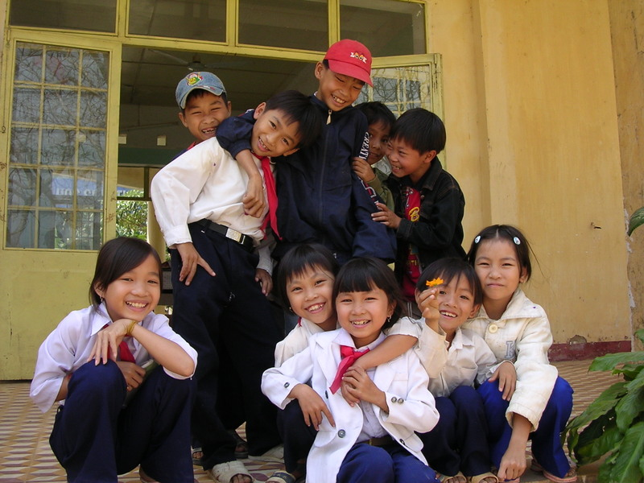
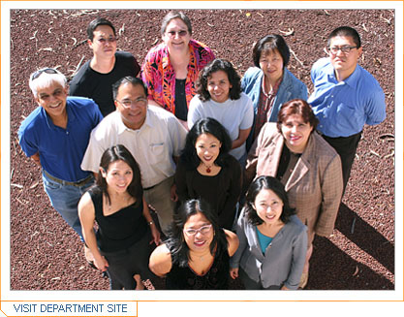


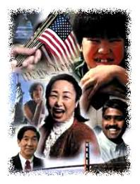
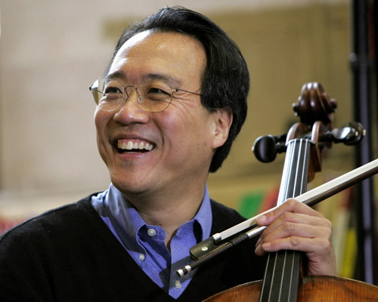
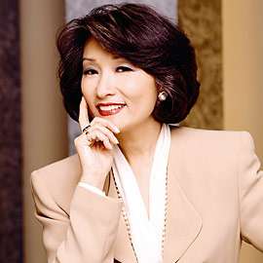
Asian Americans

Slide 8
ASIANS
Persons “having origins in any of the original peoples of the Far East, Southeast Asia, or the Indian subcontinent”.¹
FAR EAST (“ASIA”) | SOUTHEAST ASIA | INDIAN SUBCONTINENT (“South Asians”)
Iwo-Jiman Japanese Korean Chinese Mongolia Taiwanese Tibetan^{2,3} | Burmese² Malayan Bornean Mien Cambodian Mongolian Hmong Nepali² Indochinese Filipino / Pilipino Indonesian Singaporean Javanese Thai Laotian Vietnamese | Asian Indian Bangladeshi Bhutanese Maldives Nepali² Pakistani Sri Lankan Afghanistani² Burmese/Myanmar² Tibetan^{2,3}
¹U.S. Census definition. ²These groups are sometimes included in a broader definition of South Asian or South-east Asian; although they are not always identified as being of “Asian origin”. ³Although the People’s Republic of China claims sovereignty over the Tibetan people, Tibet maintains its independence as a government-in-exile. Officially, the U.S. government considers Tibet to be part of China. However, Tibet’s exiled spiritual leader, the Dalai Lama, has many supporters in the U.S. and the Congress, and Tibet’s political status remains controversial in the U.S.
Asian American Network for Cancer Awareness, Research & Education, 2000, http://aancart.org/whoareasianamericans.html; Leadership Education for Asian Pacifics, Inc. (LEAP), 2000; South Asian Public Health Association (SAPHA), 2002; U.S. Census, 2000 and 2004; U.S. Department of State: Background Notes: Taiwan, U.S. Relations, Oct 2009, http://www.state.gov/r/pa/ei/bgn/35855.htm#relations.

Slide 9
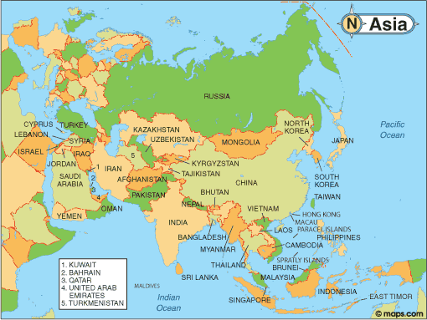
Asia
Notes:
Who are we talking about when we talk about the Asian population? Geographically, Asia includes many different countries as seen on this map. However, some of these countries are not included in the category of “Asian” on the US Census.

Slide 10
Southeast Asia:
Cambodia
Laos
Thailand Vietnam
Thailand
Notes:
What countries are usually considered under the rubric of SEA countries?
But what ethnic groups are actually usually considered as SEA refugees? Thai immigrants are not considered refugees because the country escaped invasion by the Communist government.

Slide 11
Objectives
Provide data on AA & NHPI diversity
Distinguish groups geographically and culturally
  a. Asian Americans
  NHPI
Present brief history of NHPI
Outline population changes in US
Discuss obesity trends between groups
Provide data on health disparities
7. Activity

Slide 12

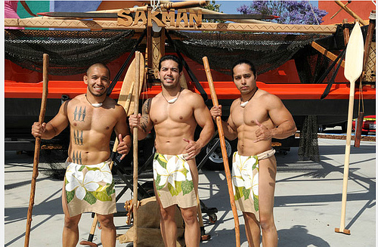
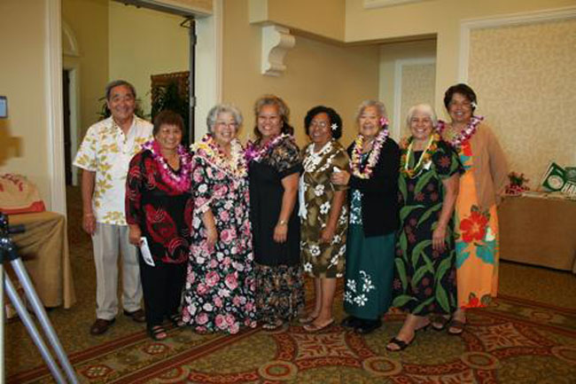
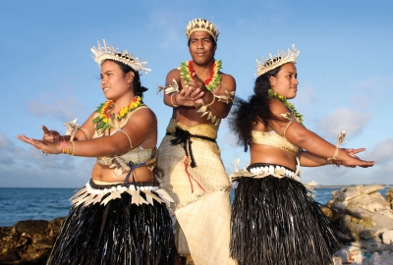
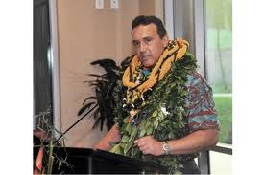
Native Hawaiians

Slide 13
NATIVE HAWAIIANS and PACIFIC ISLANDERS
Persons “having origins in any of the original peoples of Hawai`i, Guam, Samoa, or other Pacific Islands”
POLYNESIAN | MICRONESIAN |  | MELANESIAN
Cook Islander French Polynesian Maori Native Hawaiian Niuean Samoan Tongan Tahitian Tokelauan |  | Bikini Islander Marshall Islander Carolinian Marshallese Chamorro/Guamanian Palauan Chuukese/Trukese Pohnpeian / Enewetak Islander (Ponapean) I-Kiribati Saipanese Kosraean Tinian Islander Kwajalein Islander Yapese Northern Mariana Islander | Fijian Nauruan New Caledonian Ni-Vanuatu / Vanuatu Islander Papuan Papua New Guinean Solomon Islander Tuvaluan
U.S. Census: The Native Hawaiian and Other Pacific Islander Population: 2000, Census 2000 Brief, issued December 2001; Asian & Pacific Islander American Health Forum, 2000

Slide 14
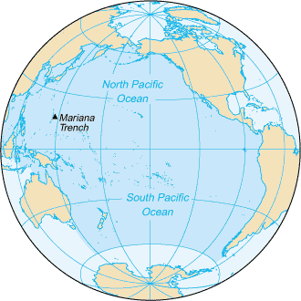
THE PACIFIC
WorldAtlas.com (http://worldatlas.com/aatlas/infopage/oceans/pacificocean.htm);
Pacific Resources for Education and Learning (http://www.prel.org/pacserv/pacserv_top.asp)
Notes:
WorldAtlas.com (http://worldatlas.com/aatlas/infopage/oceans/pacificocean.htm).
Pacific Resources for Education and Learning (http://www.prel.org/pacserv/pacserv_top.asp).

Slide 15
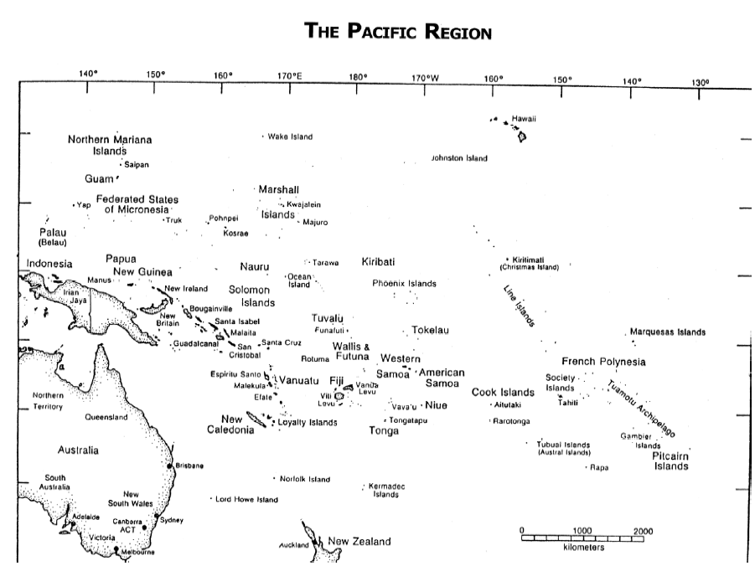
Notes:
What is often ignored or misconstrued about the Model Minority image is that there are many ethnic subgroups who are not doing so well in terms of education, socioeconomics, health status, etc. These groups tend to be the more recent immigrants such as the Pis and SEAs.
Talk about incredible diversity in these different cultures.

Slide 16
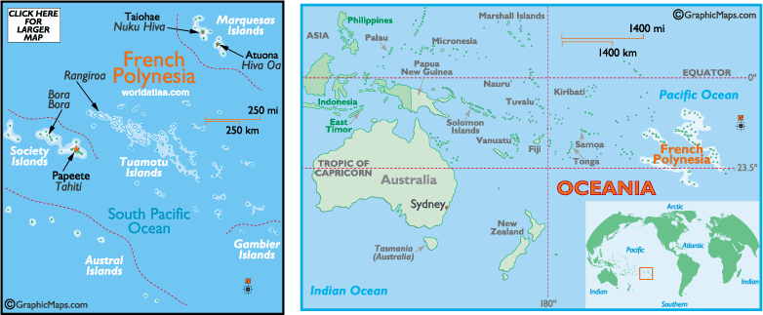
Polynesian:
Native Hawaiian, Samoan
Tongan, Tahitian, Tokelauan,
Polynesian not specified.

Slide 17


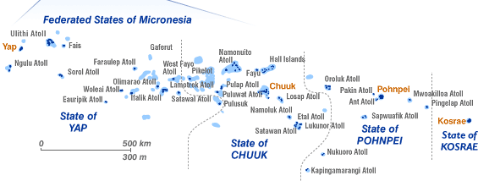
Micronesian:
Guamanian or Chamorro, Mariana Islander, Saipanese, Palauan, Carolinian, Kosraean, Pohnpeian, Chuukese, Yapese, Marshallese,
I-Kiribati, Micronesian not-specified.

Slide 18
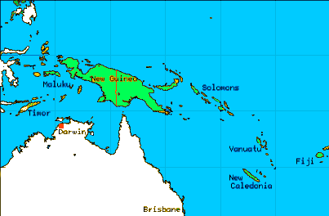
Melanesian:
Fijian, Ni-Vanuatu, Solomon Islander, Papua New Guinean, Melanesian not specified (New Caledonia, Torres Strait Islands).

Slide 19
Objectives
Provide data on AA & NHPI diversity
Distinguish groups geographically and culturally
  a. Asian Americans
  NHPI
Present brief history of NHPI
Outline population changes in US
Discuss obesity trends between groups
Provide data on health disparities
7. Activity

Slide 20
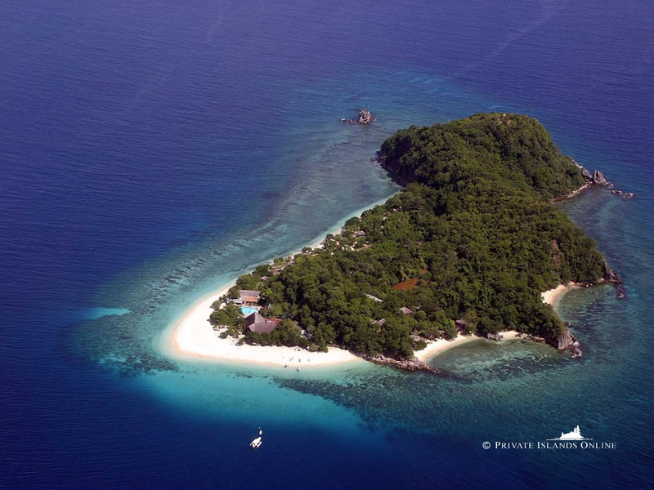
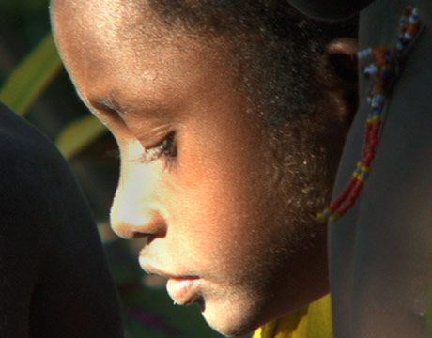
2-Minute History of Pacific Island People
Notes:
3

Slide 21
Timeline
Ice Age | Southeast Asian migrants – New Guinea and Melanesia.
5000 Yrs. Ago | Continued to migrate, populated Micronesia
3500 Yrs. Ago | Migration reached Fiji
7th – 13th Century | Polynesia inhabited inc. Hawaii
1513 AD | Spanish Explorer Vasco Nunez de Balboa 1st European to sight the Pacific Islands
1519 AD | Portuguese Explorer Ferdinand Magellan 1st European to sail Pacific Islands
1564 AD | Mexican Conquistadors led by Miguel Lopez de Legazpi sailed to Philippines and Mariana Islands
1642 AD | Dutchman Abel Tasman discovered Tasmania and New Zealand
18th Century | Russians, French, British Explorers arrive in the Pacific, notably James Cook. He made 3 voyages and studied and mapped the Pacific Islands extensively.
19th Century | Occupation of many Islands by various European countries, USA and Japan
1914 AD | Japan occupied much of the Western Pacific.
After WWII (1942) | Many of the Islands became independent.
Notes:
3

Slide 22
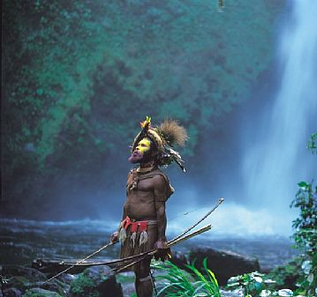
History Continued
Believed to be first discovered in the Ice Age, the Pacific Islands of Melanesia where the first to be inhabited by people.
The people migrated from Southeast Asia.
The Pacific Islands were not as separated as they are today, due to lower sea levels, which allowed the migrants to cross the water in canoes and small boats.
Notes:
3

Slide 23
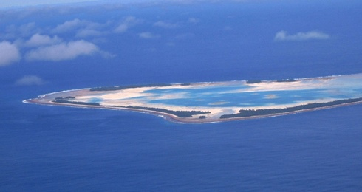
Southeast Asian Heritage
A small group of Melanesian people are thought to have continued exploring, thus linking the islands of the Polynesia and Micronesia regions genetically. All of the native island people in the Pacific have Southeast Asian heritage.
Polynesians and Micronesians are thought to be genetically linked to Melanesian ancestors, however this is contradicted by some studies.
Contradict: Disagree with or oppose.
Notes:
3

Slide 24
Objectives
Provide data on AA & NHPI diversity
Distinguish groups geographically and culturally
  a. Asian Americans
  NHPI
Present brief history of NHPI
Outline population changes in US
Discuss obesity trends between groups
Provide data on health disparities
7. Activity

Slide 25
U.S. Census by Race/Ethnicity Inclusive Population in Thousands, 2000 and 2010
Population in Thousands
↑46%
↑ 40%
U.S. Census 2000 and 2010
Notes:
U.S. Census 2000 and 2010
U.S. Asian Population is the Fastest Growing U.S. Population

Slide 26
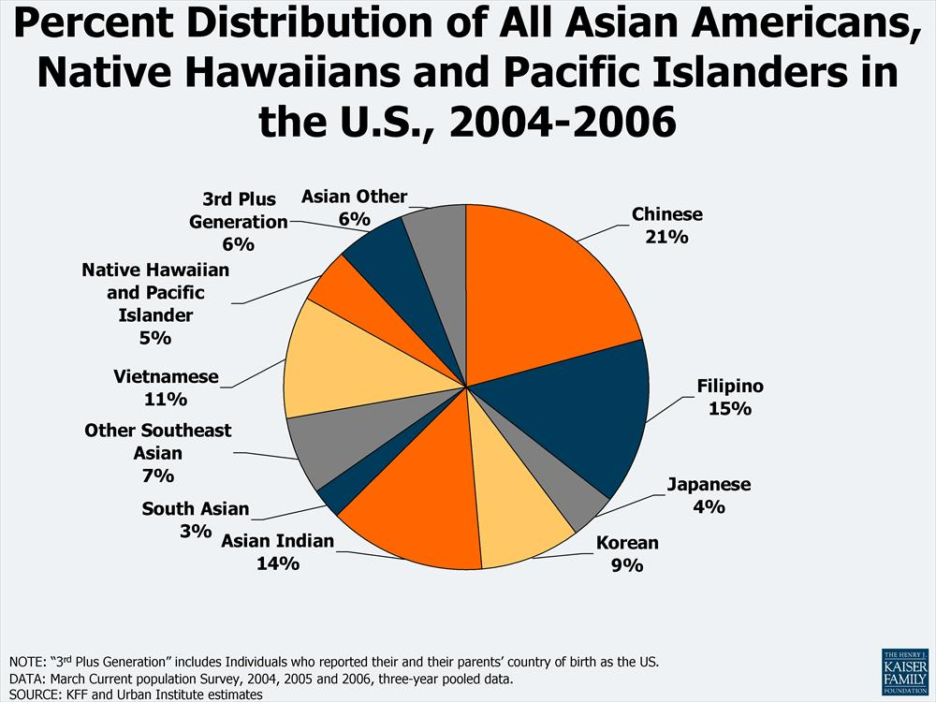

Slide 27
Objectives
Provide data on AA & NHPI diversity
Distinguish groups geographically and culturally
  a. Asian Americans
  NHPI
Present brief history of NHPI
Outline population changes in US
Discuss obesity trends between groups
Provide data on health disparities
7. Activity

Slide 28
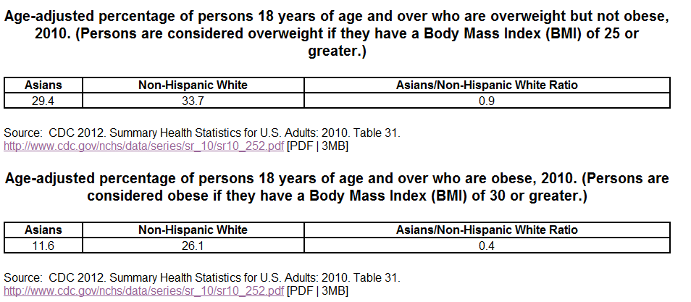
Overweight and Obesity in Asian American Adults
Notes:
3

Slide 29
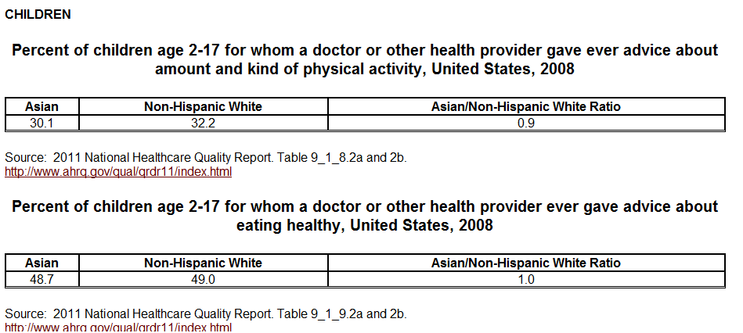
Overweight in Asian American Children
Notes:
3

Slide 30
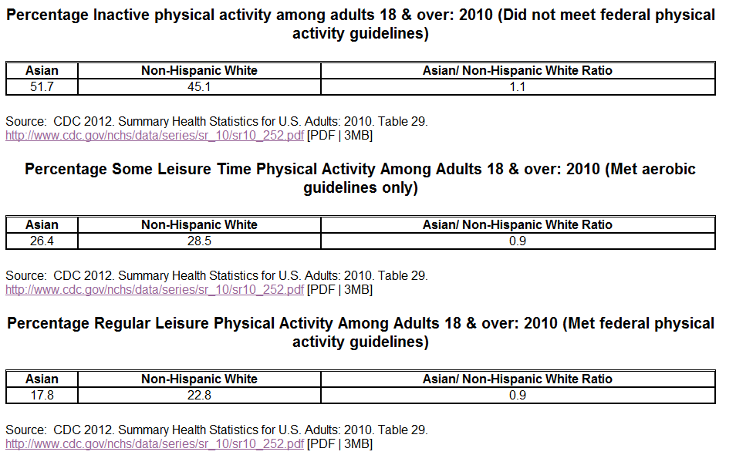
Physical Activity in Asian American
Notes:
3

Slide 31
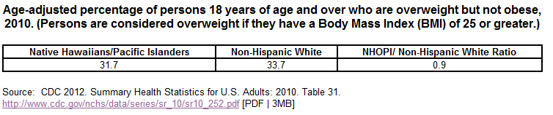
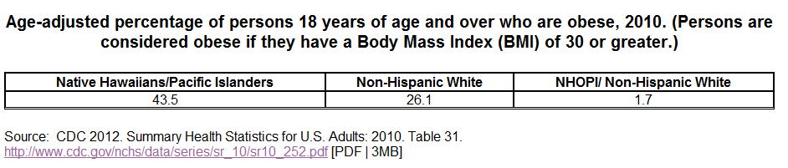
Overweight and Obesity Levels in NHPI
Notes:
3

Slide 32
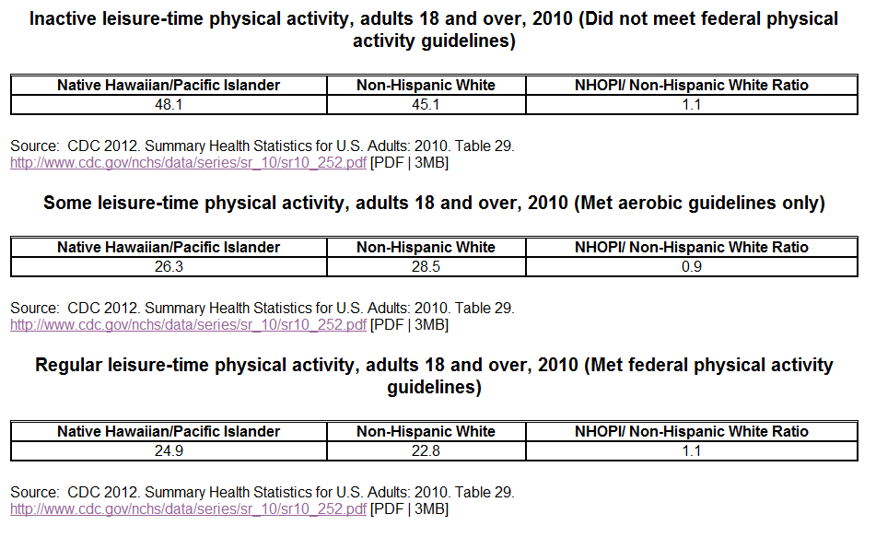
Physical Activity in NHPI
Notes:
3

Slide 33
Objectives
Provide data on AA & NHPI diversity
Distinguish groups geographically and culturally
  a. Asian Americans
  NHPI
Present brief history of NHPI
Outline population changes in US
Discuss obesity trends between groups
Provide data on health disparities
7. Activity

Slide 34
Health for Asian Americans
Health: It is significant to note that Asian American women have the highest life expectancy (85.8 years) of any other ethnic group in the U.S. Life expectancy varies among Asian subgroups: Filipino (81.5 years), Japanese (84.5 years), and Chinese women (86.1 years)¹.
Asian Americans are most at risk for the following health conditions: cancer, heart disease, stroke, unintentional injuries (accidents), and diabetes. Asian Americans also have a high prevalence of the following conditions and risk factors: chronic obstructive pulmonary disease, hepatitis B, HIV/AIDS, smoking, tuberculosis, and liver disease.
Other Health Concerns: In 2010, tuberculosis was 11 times more common among Asians, with a case rate of 22.2 as compared to 2.0 for the White population.
Source: Office of Minority Health
Notes:
3

Slide 35
Health for Native Hawaiians
It is significant to note that in comparison to other ethnic groups, Native Hawaiians/ Pacific Islanders have higher rates of smoking, alcohol consumption, and obesity.
This group also has little access to cancer prevention and control programs.
Some leading causes of death among Native Hawaiians/Pacific Islanders include: cancer, heart disease, unintentional injuries (accidents), stroke and diabetes.
Some other health conditions and risk factors that are prevalent among Native Hawaiians and Pacific Islanders are hepatitis B, HIV/AIDS, and tuberculosis.
The infant mortality rate (deaths per 1,000 live births) for Native Hawaiians in 2002 was 9.6, higher than the rate for all Asian-American/Pacific Islander groups combined (4.8) and for all population (7.0).
The tuberculosis rate (cases per 100,000) in 2010 was 8 times higher for Native Hawaiian/Pacific Islanders, with a case rate of 16.6, as compared to 2.0 for the White population.
Source: The Office of Minority Health
Notes:
3

Slide 36
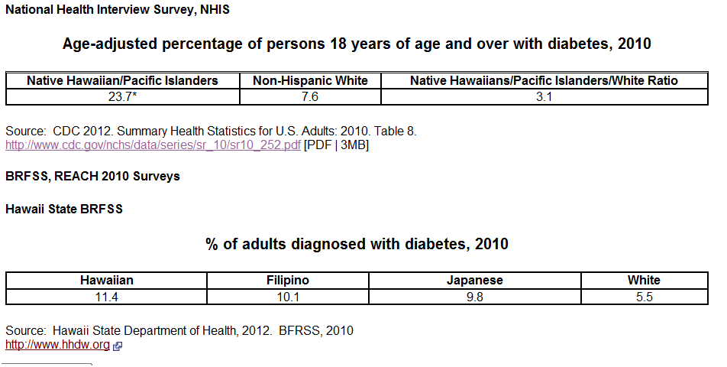
Diabetes in NHPI
Notes:
3

Slide 37
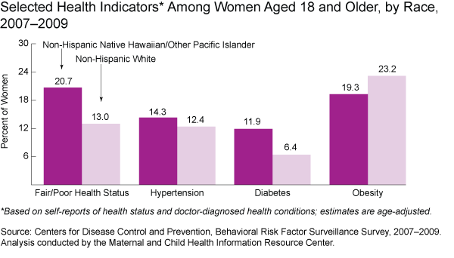
Other Health Disparities in NHPI

Slide 38
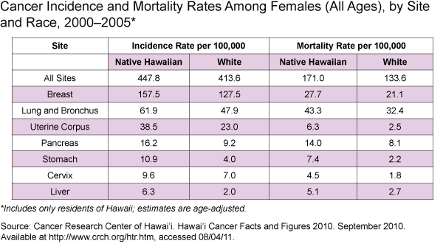

Slide 39
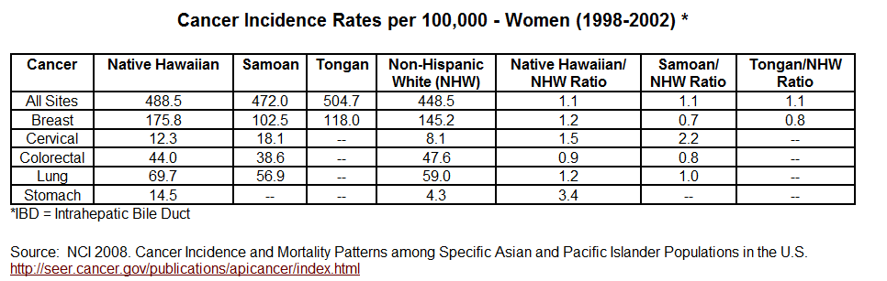
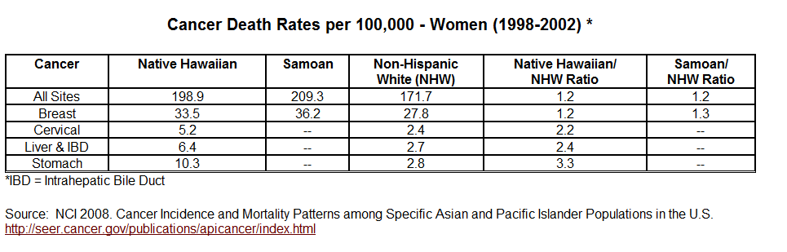
Cancer Incidence and Survival
Notes:
3

Slide 40
Social Determinants of Health Disparities
Social Economic Status – how does this relate to health and childhood obesity?
Food security and insecurity
Immigration/acculturation issues
Neighborhood characteristics
Notes:
3

Slide 41
Objectives
Provide data on AA & NHPI diversity
Distinguish groups geographically and culturally
  a. Asian Americans
  NHPI
Present brief history of NHPI
Outline population changes in US
Discuss obesity trends between groups
Provide data on health disparities
7. Activity

Slide 42
Activity
In groups of four – discuss and answer the following questions:
  Are AA and NHPI different?
  Discuss the differences –
  Why are these differences important in terms of addressing health and in addressing childhood obesity?
Notes:
3

Slide 43

Acknowledgements/References
Mavis Nitta, MPH, CHES
The Office of Minority Health
Centers for Disease Control
Dr. Tu-Uyen Nguyen
Slideshare

